Slide 1
Two horizons for digital transformation
Patrick Lambe, Straits Knowledge Maish Nichani, PebbleRoad
ISKO Singapore Workshop 27 July 2018

Slide 2
Basic Principles: Horizons of Change - the Flywheel Project and the Landscape Review
Agility and learning - Double Loop Learning and Double Loop Transformation
Which Comes First? Landscape Review or Flywheel Project?
Levers of Sustainable Change: Scoping a Digital Transformation Project

Slide 3
Session 1 - Basic Principles

Slide 4
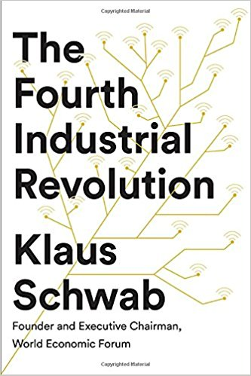
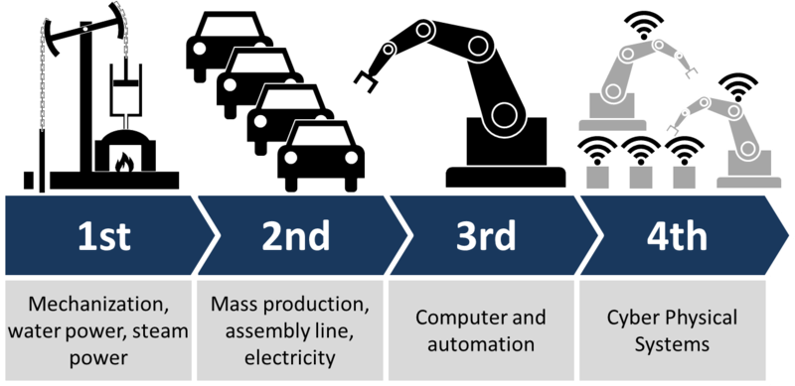
Notes:
Cyber physical social systems may be a better description for the 4th generation.

Slide 5
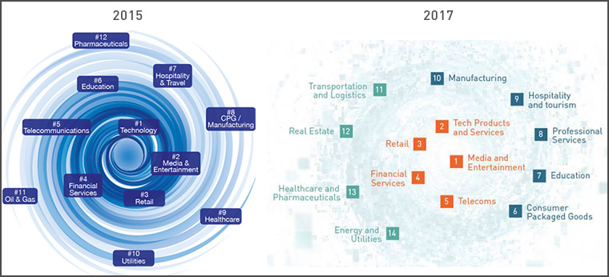
IMD’s Digital Vortex
Notes:
https://www.imd.org/dbt/articles/digital-vortex-in-2017/

Slide 7
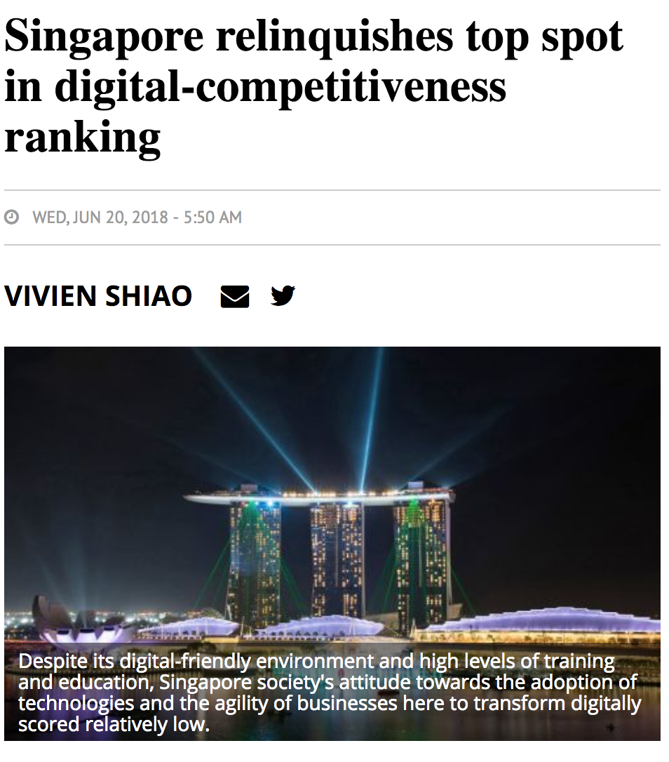
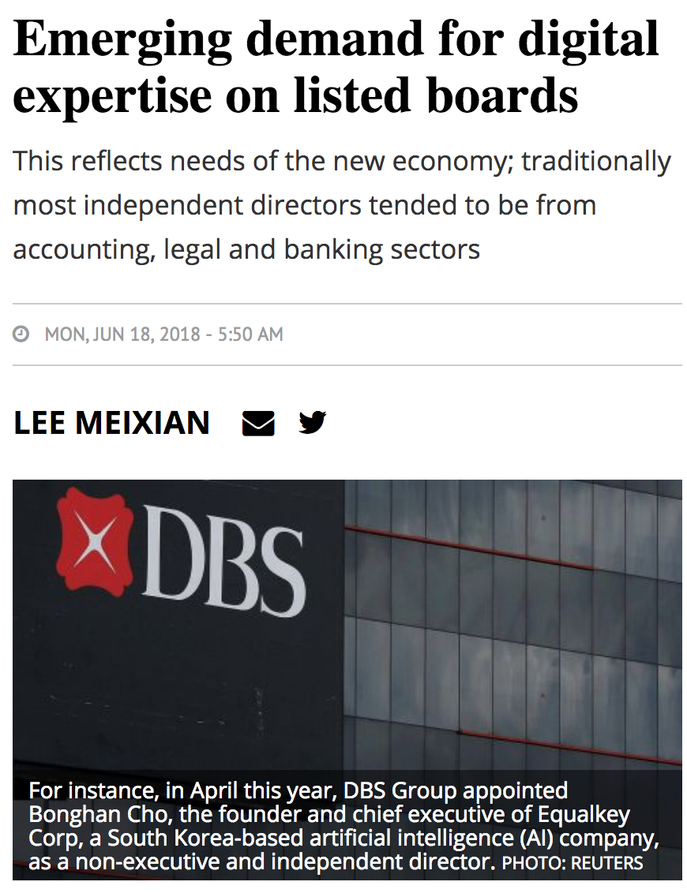
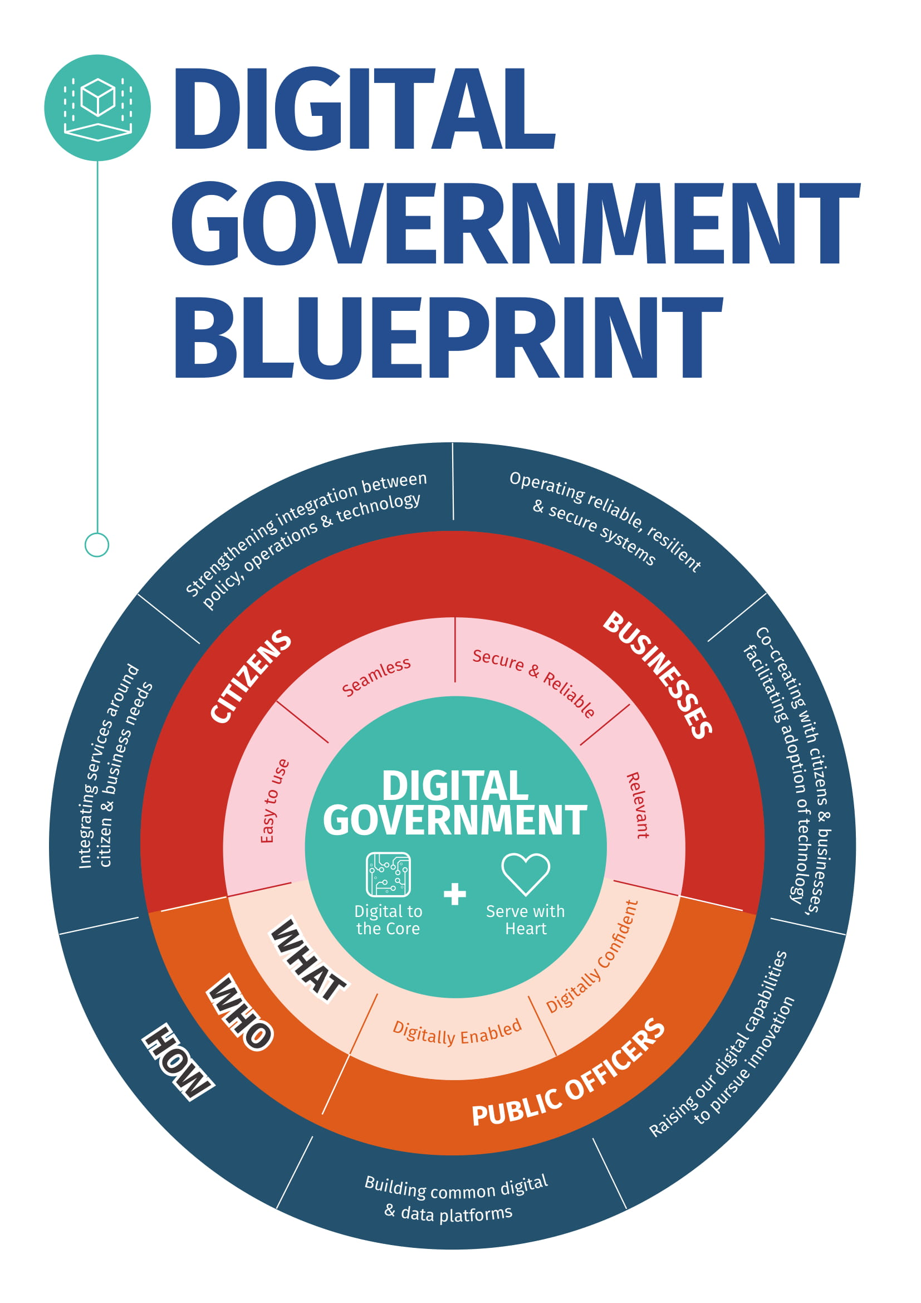
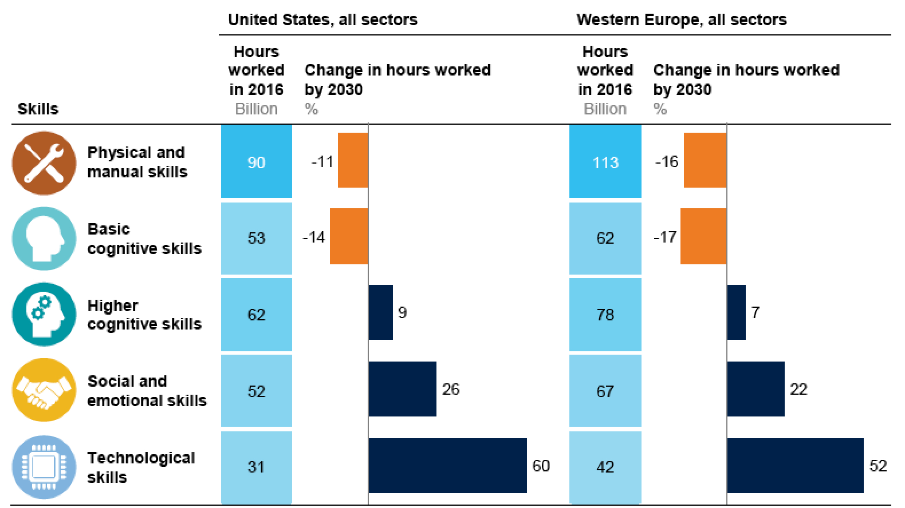
McKinsey Global Institute May 2018
Notes:
McKinsey Global Institute discussion paper May 2018: https://www.mckinsey.com/featured-insights/future-of-organizations-and-work/skill-shift-automation-and-the-future-of-the-workforce
https://www.tech.gov.sg/Digital-Government-Transformation/Digital-Government-Blueprint

Slide 8
Discussion
Is your organisation undergoing digital transformation?
What does it look like?
How is it different from / same as the “other” change initiatives you have been part of over the years?

Slide 9
“Many organizations are still confused as to what DBT really means. IMD’s Global Center for Digital Business Transformation defines it as ‘organizational change through the use of digital technologies and business models to improve performance.’ In other words, what’s important is not the digital technologies themselves. The real focus is on transforming the business; technology only serves to support the new business model.”
Digital business transformation – Getting it right https://www.imd.org/research/insightsimd/DigitalbusinesstransformationGettingitright/
Notes:
Bill Proudfit: Can we be clearer about what these new business models look like and how similar or different they are? I wonder if we are making too much of a big deal about the degree of change. People can become frightened of too much change.

Slide 10
“Digital is not just a thing that you can you can buy and plug into the organization. It is multi-faceted and diffuse, and doesn’t just involve technology. Digital transformation is an ongoing process of changing the way you do business. It requires foundational investments in skills, projects, infrastructure, and, often, in cleaning up IT systems. It requires mixing people, machines, and business processes, with all of the messiness that entails. It also requires continuous monitoring and intervention, from the top, to ensure that both digital leaders and non-digital leaders are making good decisions about their transformation efforts.”
Why So Many High-Profile Digital Transformations Fail Harvard Business Review https://hbr.org/2018/03/why-so-many-high-profile-digital-transformations-fail
Notes:
Is this another management fad in the genealogy from Business Process Transformation to Knowledge Management to Digital Business Transformation?

Slide 11
NOT like this
How to redirect mail to new address

Slide 12
NOT like this
How to go paperless
Notes:
Reference: Digital Lipstick on a Legacy Pig by Vaasu Gavarasana https://www.amazon.com/Digital-Lipstick-Legacy-Practitioners-Transformation/dp/1537636421

Slide 13
3 current focus areas of digital transformation
Customer experience
Operational efficiency
New business models
Notes:
Examples of new business models: platform businesses, Uber, blockchain financial services.

Slide 14
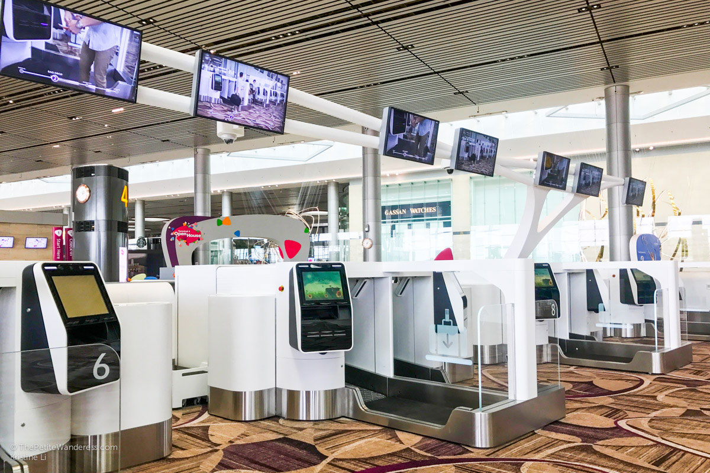
Changi T4
Customer experience

Slide 15
SATS
Operational efficiency

Slide 16
OCBC bank
New business models

Slide 17
Benefits of digital transformation
Value
Profitability
Satisfaction
Operational efficiency
Customer experience
Easier
Faster
Smarter
Easier
Faster
Smarter
Data
Information Knowledge
Data
Notes:
This is an exemplar slide showing where a lot of DT projects are currently focused. There is no reason why other strategic drivers could not be the focus for DT - for example, organisation effectiveness, risk avoidance, scaling operations (see slide 23). Must not forget that for operational efficiency improvements it’s not just data from and about the customer that counts, but also data, information and knowledge on how internal processes are connected and transact with each other.

Slide 18
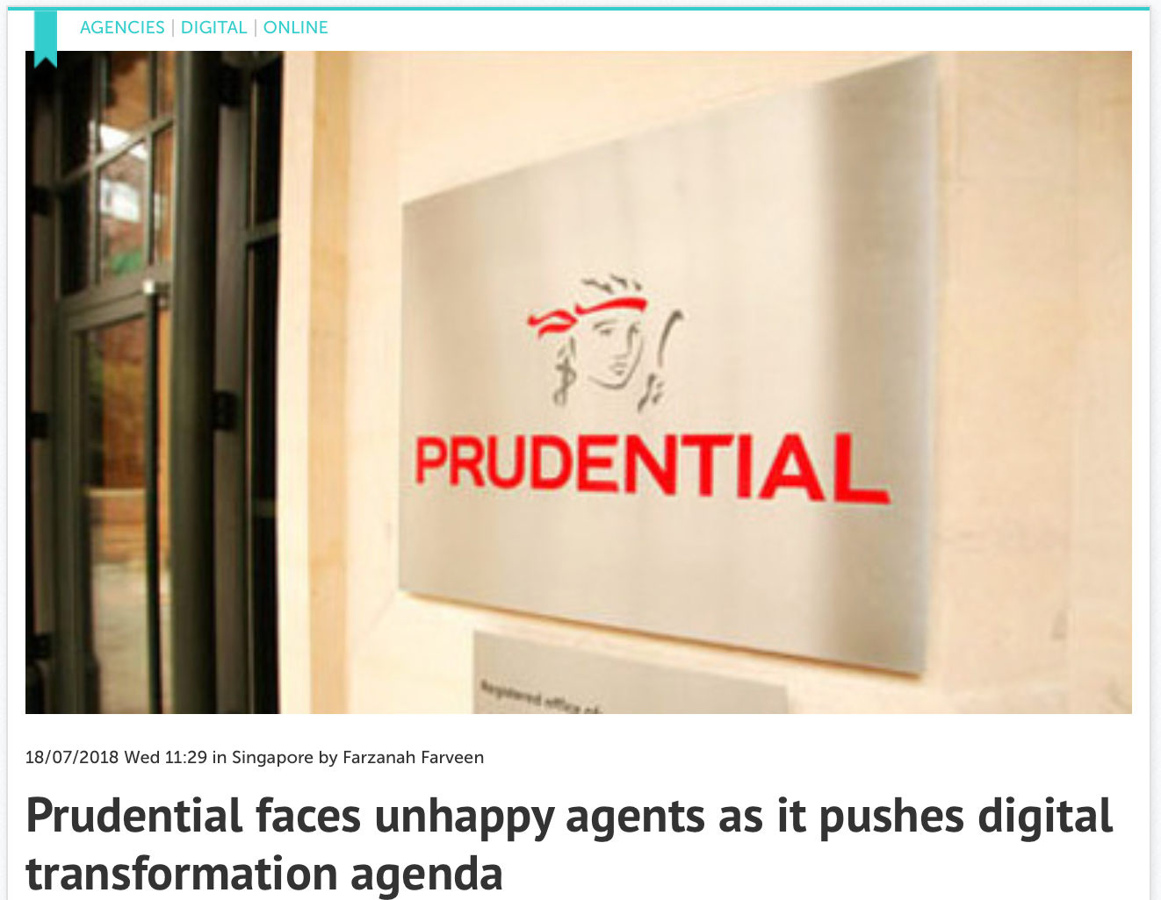
Downsides of digital transformation
Treating it as a standalone project - unintended effects
Notes:
http://www.marketing-interactive.com/prudential-faces-unhappy-agents-as-it-pushes-digital-transformation-agenda/

Slide 19
Principles
It’s not just about technology
Everything is connected

Slide 20
Two possible starting points
Flywheel projects
Landscape review
Learn through doing
Expand and deepen
Understand capabilities
Set goals
Notes:
Reference: Jim Collins Good to Great, originated the flywheel idea. https://www.amazon.com/Good-Great-Some-Companies-Others/dp/0066620996/ref=sr_1_1?s=books&ie=UTF8&qid=1532932956&sr=1-1&keywords=good+to+great

Slide 21
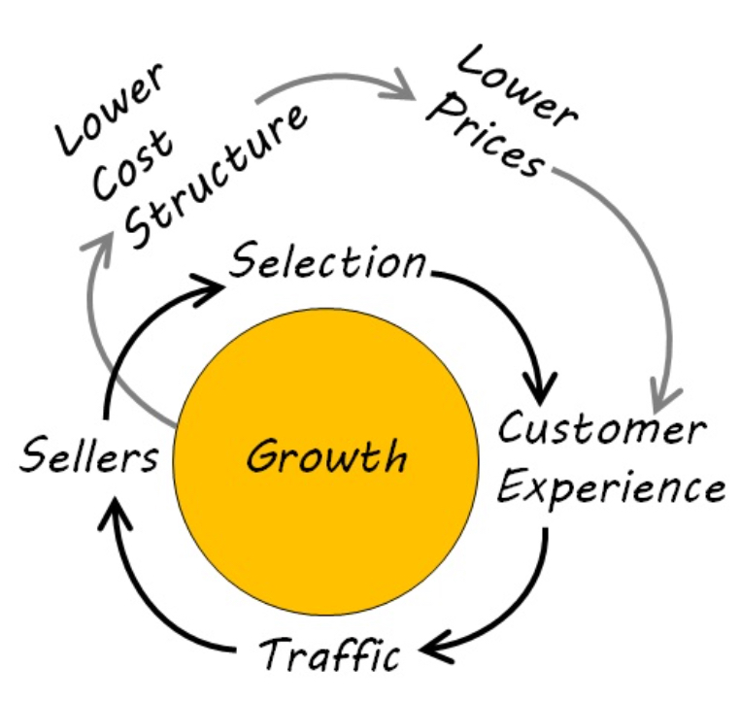
Flywheel projects
How do we pick a good bet for a flywheel?
Steady
Consistent
Aligned
Compounding
Over time
Keystone
Is the flywheel really engaging with the org’s ecosystem?
Flywheel: a heavy revolving wheel in a machine which is used to increase the machine's momentum and thereby provide greater stability or a reserve of available power.
Notes:
https://www.inc.com/jeff-haden/the-1-principle-jeff-bezos-and-amazon-follow-to-fuel-incredible-growth.html
Flywheel projects pay off on a larger, longer-term scale when they become keystone elements in the organisational ecosystem, spawning new benefits beyond the scope of the original project goal.

Slide 22
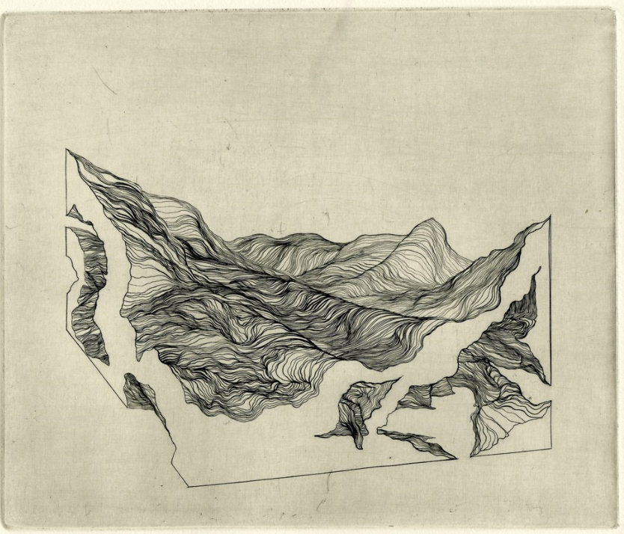
Landscape review
Strategic landscape
Operational landscape
Notes:
Reference: Gary Hamel Harvard Business Review 2000 – Waking up IBM https://hbr.org/2000/07/waking-up-ibm-how-a-gang-of-unlikely-rebels-transformed-big-blue

Slide 23
Landscape review - Strategic
What are your strategic goals?
What are your capabilities supporting those goals?
Where are your capability improvement needs?

Slide 24
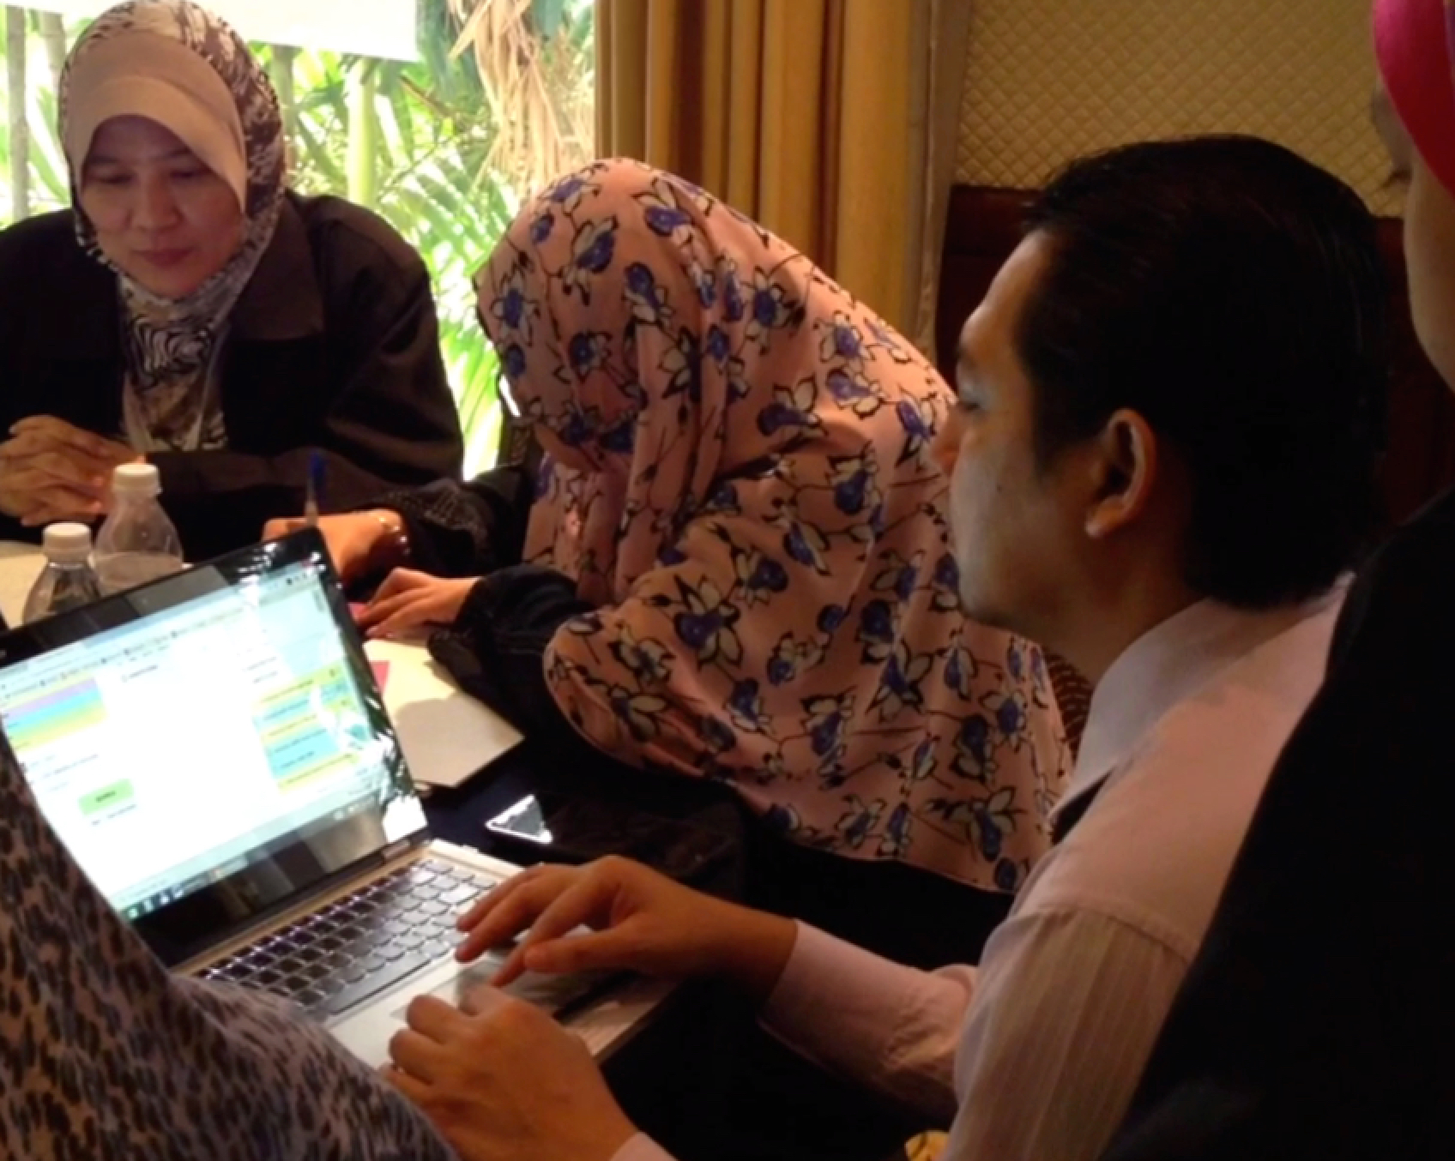
Landscape review - Operational
What are your key business functions and critical business activities?
What knowledge underpins your ability to perform them?
Where are your pain points around coordination, learning and memory?
What is your culture around learning and change?

Slide 25
Principles
It’s not just about technology
Everything is connected
To make good strategic bets we need self-knowledge

Slide 26
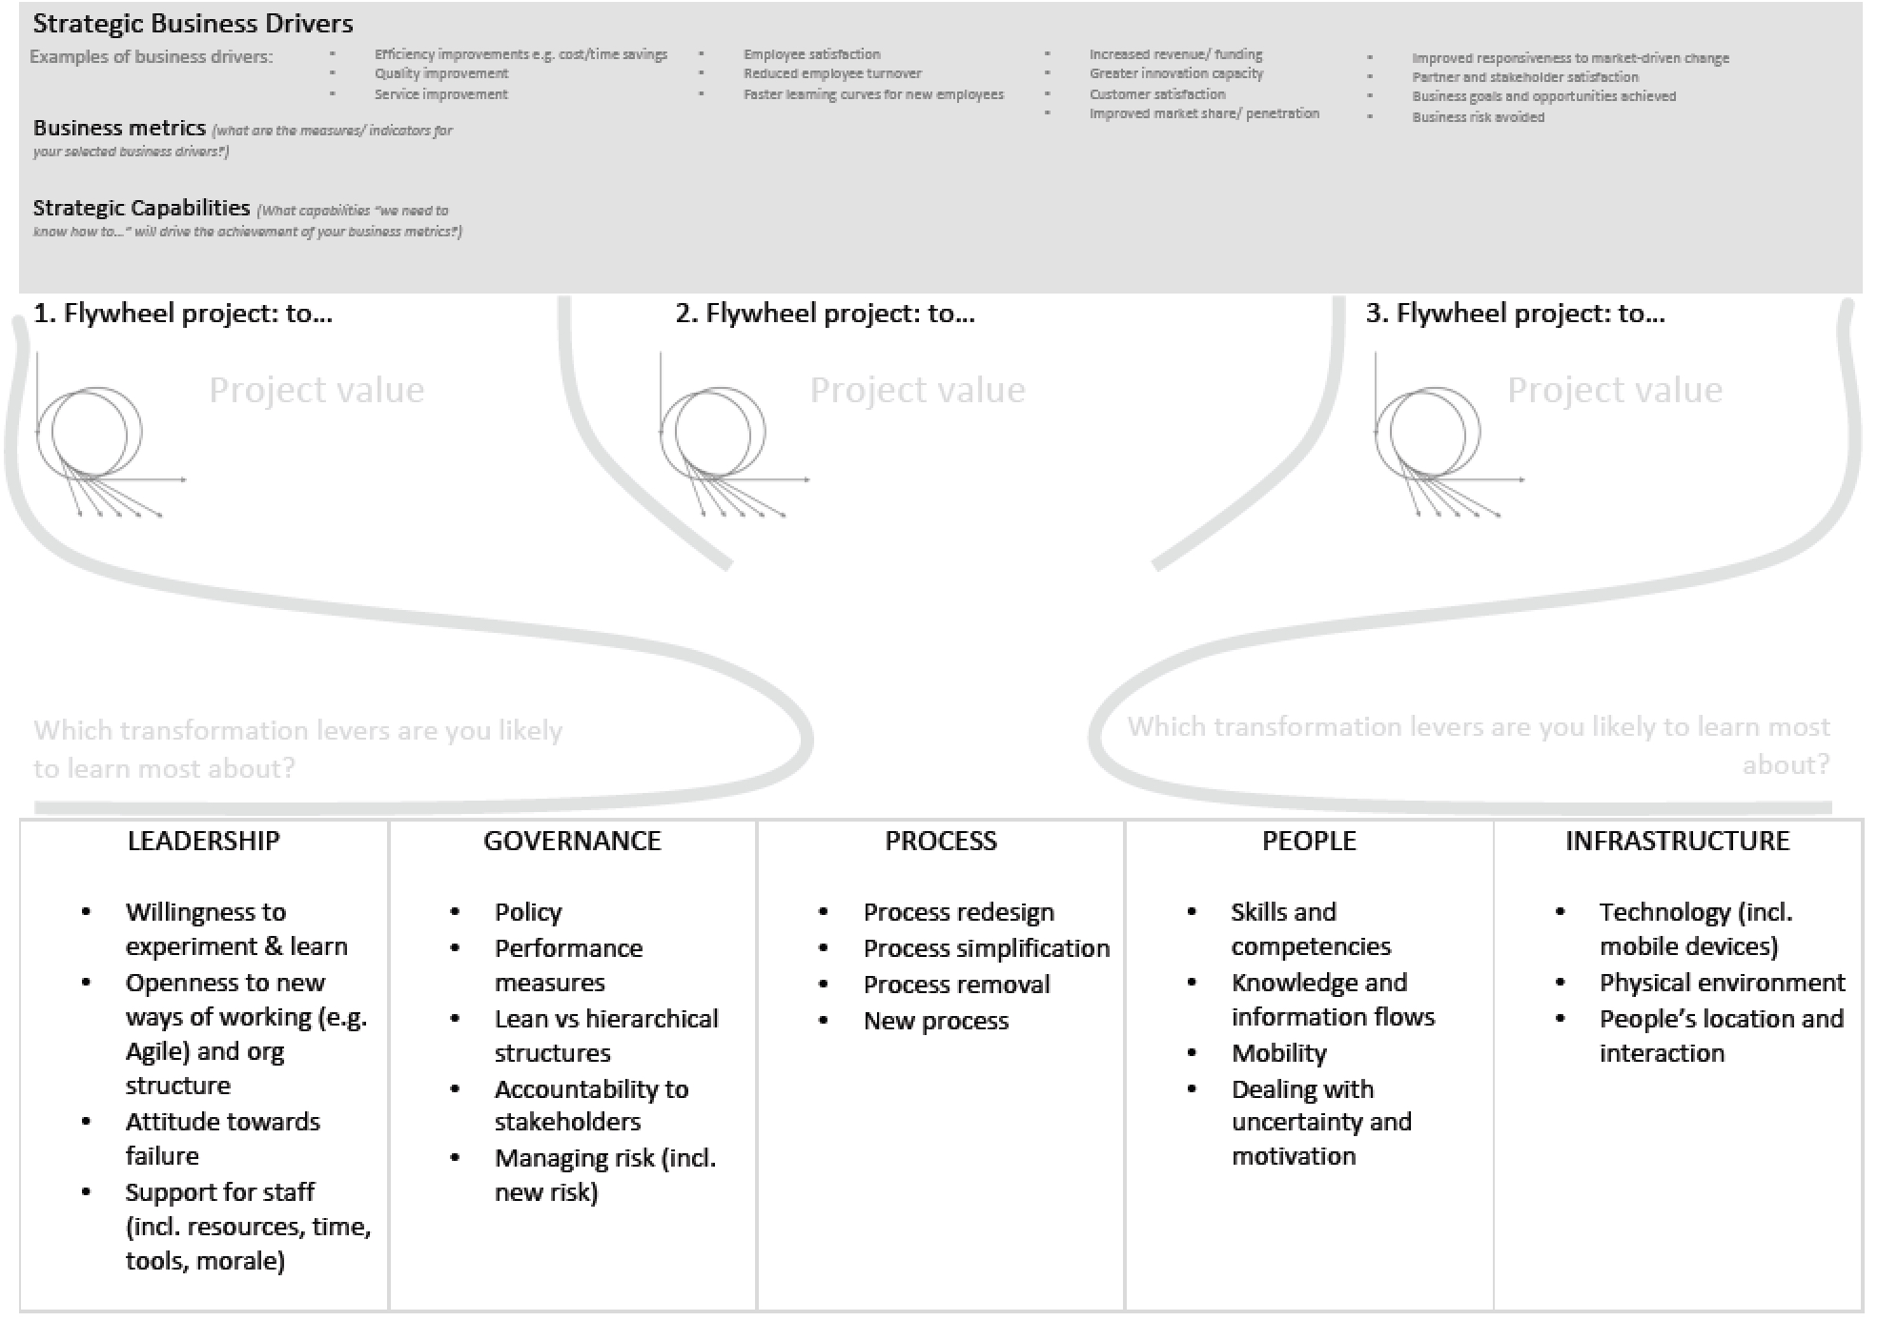
Exercise: making strategic bets

Slide 27
Session 2 - Agility
Notes:
Agility is not just about speed, but the ability to respond nimbly to events, working together, ability to coordinate and organise in new ways.

Slide 28
We are living in a VUCA world
Mechanistic
Agility
Notes:
Mechanistic is heavy on planning, and does not easily accommodate unexpected events. New destinations have to be re-planned and the original plan itself can get in the way of reaching it. Agility gives you the capacity to change direction quickly as you learn. Learning and reassessing is built into the agile mindset.

Slide 29
Right approach: DT, Lean, Agile
Fuzzy state
Steady state
DT
Lean
Agile

Slide 30
Right approach: DT, Lean, Agile
Fuzzy state
Steady state
Agility requires one organising mode. Moving to steady exploitation mode requires another
DT
Lean
Agile
How frequently do we need to cycle between modes?

Slide 31
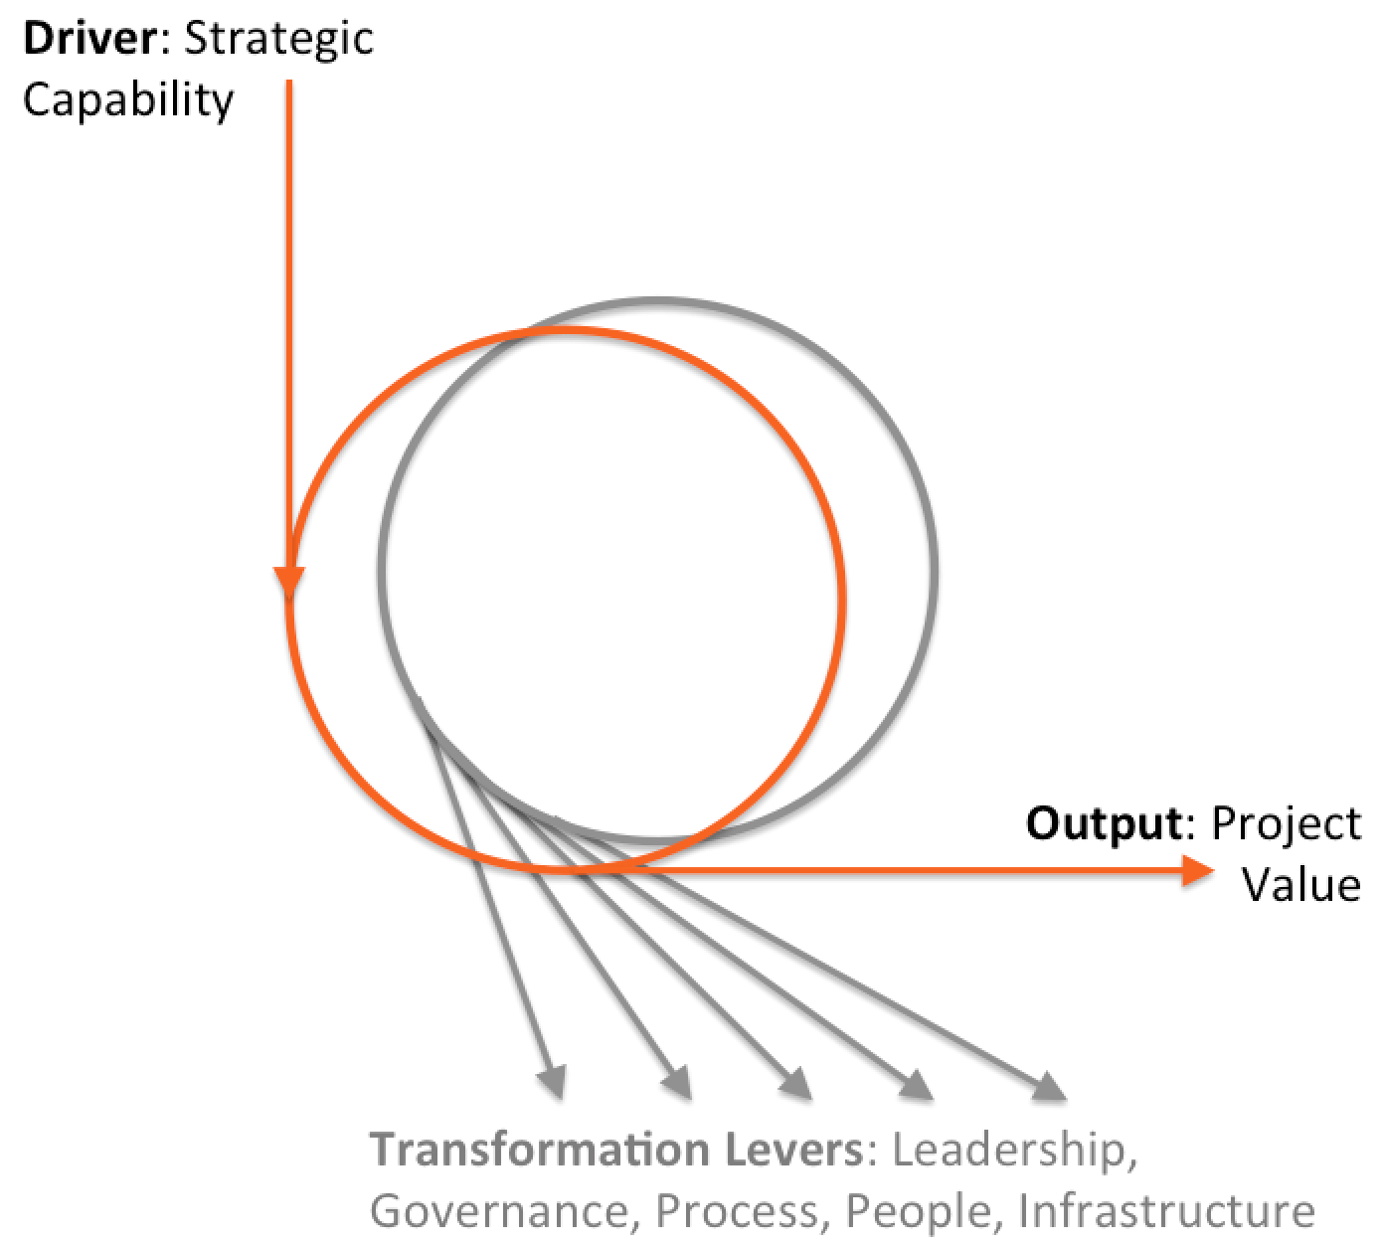
Double loop learning
“Most people define learning too narrowly as mere ‘problem-solving’, so they focus on identifying and correcting errors… Solving problems is important. But if learning is to persist, managers and employees must also look inward. They need to reflect critically on their own behavior, identify the ways they often inadvertently contribute to the organisation’s problems, and then change how they act.”
Chris Argyris ‘Teaching Smart People How to Learn’
Notes:
Chris Argyris ‘Teaching Smart People How To Learn’ Harvard Business Review May-June 1991
https://hbr.org/1991/05/teaching-smart-people-how-to-learn

Slide 32
Digital transformation project
A project that is not just an end in itself, but is also a trigger to address people, process and tech gaps standing in the way of digital progress.
We call such long-term, strategic projects “digital transformation projects” and address them with our double-loop strategy.
Digital
Loop 1
Transformation
Leadership, Governance, Process, People, Infra
DT, Lean, Agile
Loop 1
Loop 2

Slide 33
Double-loop transformation
Short-term
Mid-term
Long-term
Projects
Programmes
Portfolios
Assembled team
Dedicated teams
Transformation office
Traditional
Digital
Notes:
https://hbr.org/2000/07/waking-up-ibm-how-a-gang-of-unlikely-rebels-transformed-big-blue
Gary Hamel ‘Waking Up IBM: How a Gang of Unlikely Rebels Transformed Big Blue’, Harvard Business Review July-Aug 2000

Slide 34
Principles
It’s not just about technology
Everything is connected
To make good strategic bets we need self-knowledge
There is no end state
Agility requires capabilities in coordination, learning (+unlearning) and memory

Slide 35
Case studies

Slide 37
Session 3 - Sequencing

Slide 38
Which comes first?
Flywheel projects
Landscape review
Learn through doing
Expand and deepen
Understand capabilities
Set goals

Slide 39
Which comes first?
Start with...
Flywheel Projects |  | Landscape Review
Pros | Cons | Pros | Cons

Slide 40
Session 4 - Scoping

Slide 41
Levers of sustainable change
Everything is connected!

Slide 42
Exercise: scoping a DT project

Slide 43
Final Thoughts

Slide 44
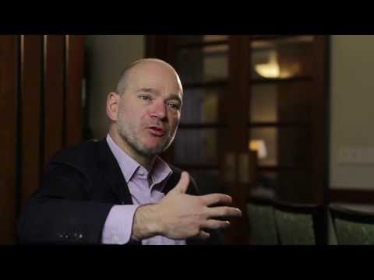
Notes:
https://youtu.be/AZ5ePL36BbU - use this as closing reflection. Are WE going to get our heads cut off once the extent of change is realised?

Slide 45
“...the prospect of launching a sexy technology-based business is tantalizing. The allure of digital can become all-consuming, causing executives to pay too much attention to the new and not enough to the old. Sears’ investments in analytics were not a bad idea, but the company’s facilities and service needed investment more.”
Why So Many High-Profile Digital Transformations Fail Harvard Business Review https://hbr.org/2018/03/why-so-many-high-profile-digital-transformations-fail

Slide 46
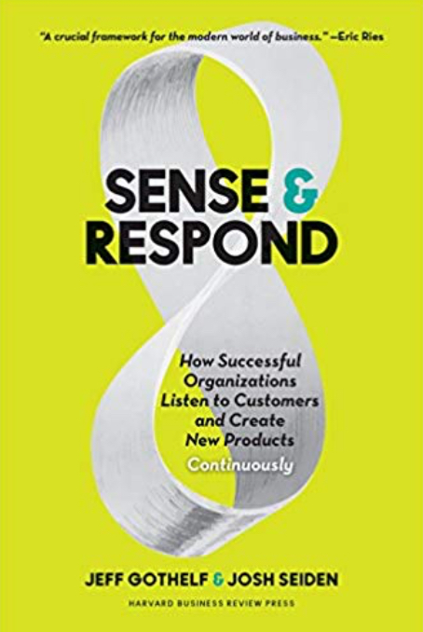
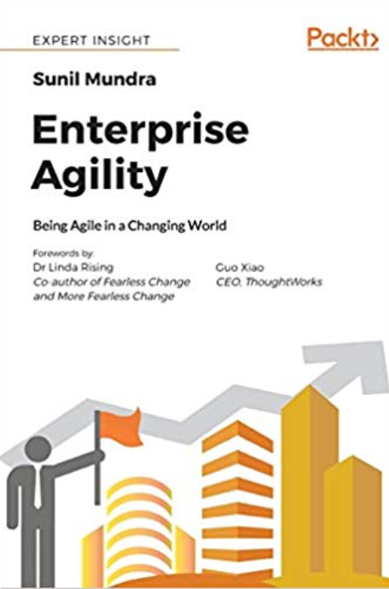
Books
Klaus Schwab The Fourth Industrial Revolution (New York: Crown, 2017)
Jeff Gotthelf, Josh Seiden Sense and Respond: How Successful Organizations Listen to Customers and Create New Products Continuously (Cambridge, MA: HBR Press, 2017)
Sunil Mundra Enterprise Agility: Being Agile in a Changing World (Birmingham: Packt, 2018)

Slide 47
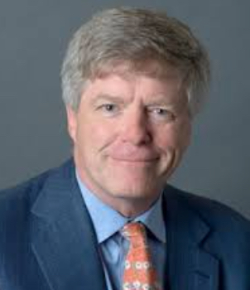
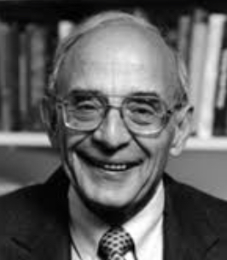
Papers and Reports
Thomas Davenport and George Westerman ‘Why so many high profile digital transformations fail’ Harvard Business Review March 2018
Chris Argyris ‘Double-loop learning in organizations’ Harvard Business Review September 1977
Michael Wade et al. ‘Orchestrating digital business transformation’ IMD June 2017
https://hbr.org/2018/03/why-so-many-high-profile-digital-transformations-fail
https://hbr.org/1977/09/double-loop-learning-in-organizations
https://www.imd.org/dbt/insights/digital-orchestra/
Notes:
https://hbr.org/2018/03/why-so-many-high-profile-digital-transformations-fail
https://hbr.org/1977/09/double-loop-learning-in-organizations
https://www.imd.org/dbt/insights/digital-orchestra/

Slide 48
Thank You
Maish Nichani, maish@pebbleroad.com
Patrick Lambe, plambe@straitsknowledge.com
www.iskosg.org

Slide 49
Upcoming ISKO SG events
17 August: Pitching the Business Case for KM to Senior Leadership - Nick Milton, Kan Siew Ning and Megan Stokes
21 September: Knowledge Management and Digital Transformation: The role of KM in building an agile workforce - Shaharudin Mohd Ishak
11 October: Build it So They Come: Designing a Knowledge System for Adoption - followed by ISKO SG AGM
www.iskosg.org

