Slide 1
Taxonomy 101 Workshop
ISKO Singapore – June 2019
Patrick Lambe, Straits Knowledge

Slide 2
Agenda
What is a taxonomy supposed to do?
Taxonomy design: purpose, scope of content, users
Identifying the Business Purpose
Taxonomy development: evidence-based approach
Warrant – content, user, standards
Use Cases for Taxonomy and Search
Content Modelling to identify useful taxonomy facets
Content Warrant: Sources of Evidence for Vocabularies
Criteria for inclusion and exclusion
Practical Taxonomy Building Exercise

Slide 3
What is a taxonomy and what does it do?

Slide 4
VOCABULARY
A controlled set of tags / category labels
Makes Search smarter!! FIND + DISCOVER
PROBLEM: Search engines only read the words you use in a document. It only knows that things are connected to each other in other ways if you tell it.
A TERM IN A DOCUMENT DOESN’T MEAN THE DOCUMENT IS ABOUT THAT TOPIC
PROBLEM: The way you describe something is different from the way others describe the same thing.
SYNONYMY + POLYSEMY
Taxonomy
CLASSIFICATION
Used to connect related resources to each other, even if they are described with differing language
MAP
Used to organise information resources so they can be explored
PROBLEM: Your team organises your stuff in ways that suit you. They may not be transparent to people from other teams.
HISTORICAL BAGGAGE + LACK OF GOVERNANCE
PROBLEM: What belongs together for one function is not the same as what belongs together for another function.
DIFFERENT BUSINESS NEEDS

Slide 5
FIND + DISCOVER
VOCABULARY
KEYWORD SEARCH
Taxonomy
CLASSIFICATION
EXPLORE
ORIENTATION PAGES
SITE MAPS
TOPIC PAGES
MAP
BROWSE
FILTER
SEARCH EXPANSION

Slide 6
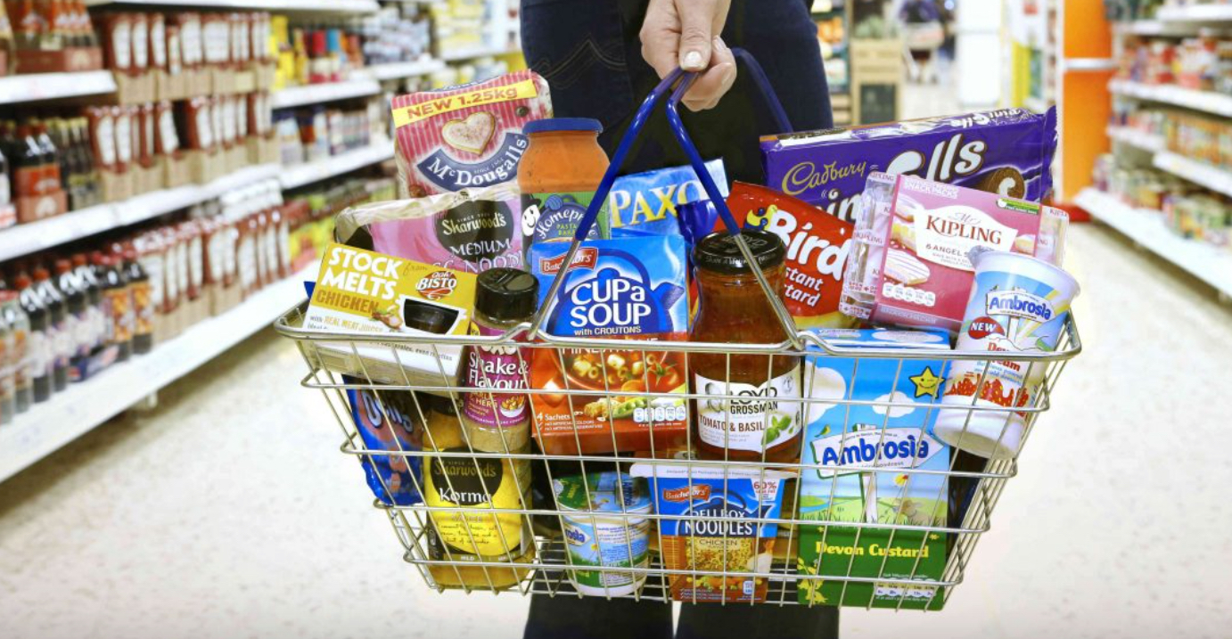
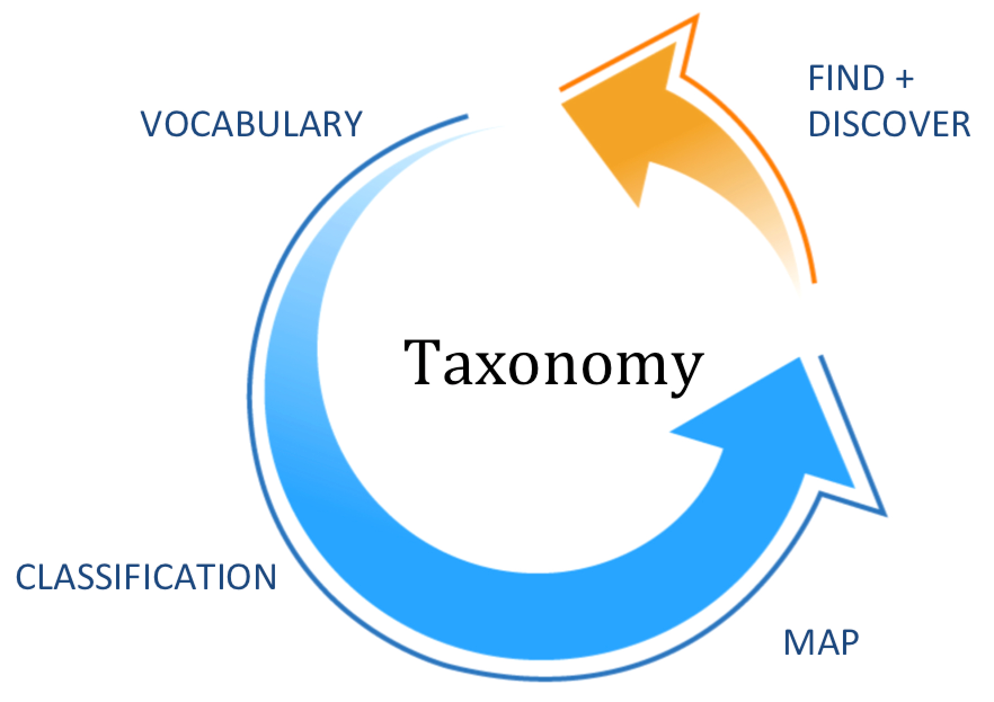
How does a supermarket use vocabulary?
How are things grouped together?
Are all supermarkets organised the same way?
Why and how do supermarket arrangements keep changing?
Who uses the supermarket taxonomy?
How do you know when a supermarket taxonomy is working?

Slide 7
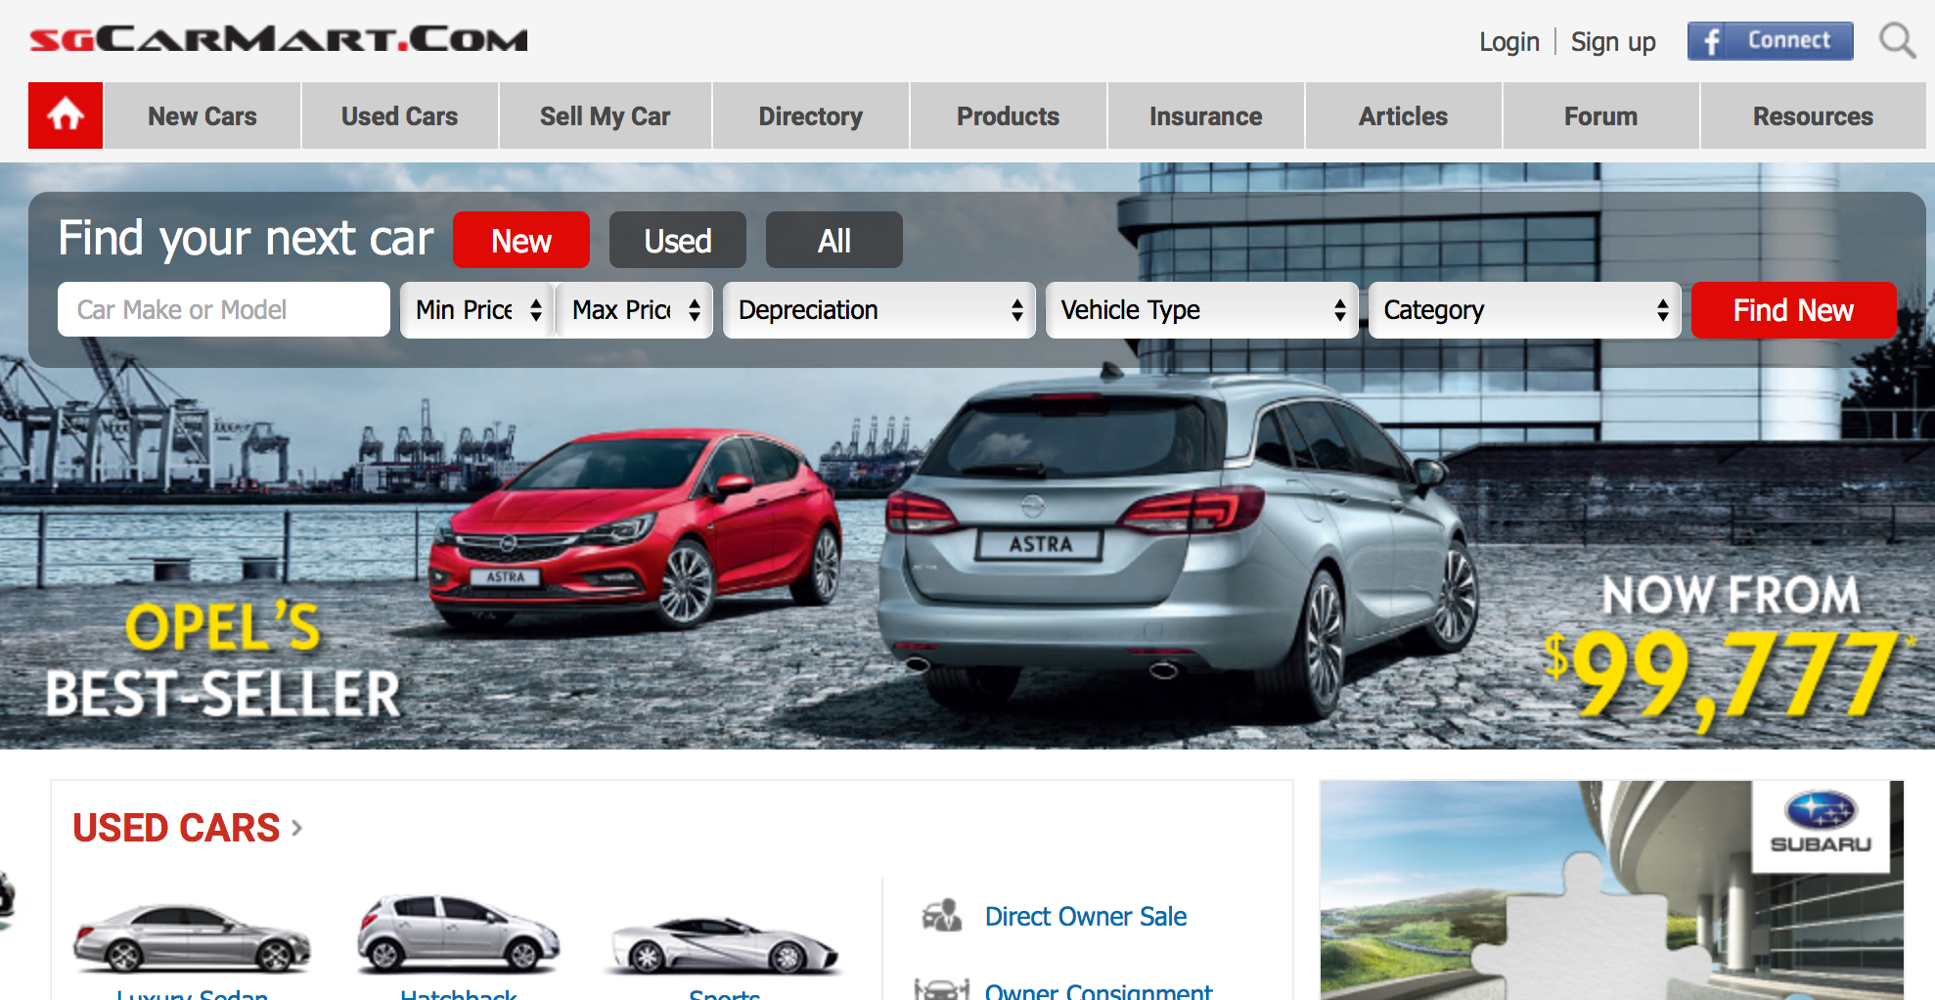
How does an ecommerce site use vocabulary?
How are things grouped together?
Are all ecommerce sites organised the same way?
Why and how do site presentations keep changing?
Who uses the site taxonomy?
How do you know when an ecommerce taxonomy is working?

Slide 8
Can we connect our current knowledge and information to key past records of our decisions, rationales, actions, commitments?
What happens when our language changes?
E.g. Infectious diseases vs. Communicable diseases?
Can we collaborate and share across silos? Can we prevent reinvention of the wheel?
Different teams use different language, and need to organise their information differently
Are we able to spot emerging risks and opportunities, give them clear labels, so that we can organise information and create insights around them?
Can the taxonomy keep pace with new vocabularies as they emerge? E.g. Structured Investment Vehicles in financial crash of 2007
Taxonomy & Search
Remembering
Coordinating
Learning
Can we access our past knowledge, and apply it to new situations?
Does the right hand know what the left hand is doing? Can we find and reuse useful knowledge from elsewhere in the organisation?
Can we learn, adapt and innovate to meet new needs as they arise?
Notes:
Patrick to lead on this, Jasmine to support with more details on projects as needed

Slide 9
How can Taxonomy & Search improve the way you work?
Common framework/language
Easier to find and share relevant documents & content
Knowledge becomes more visible
Documents become more accessible, visible and less likely to be lost or ignored
Collaboration becomes easier
Visibility into other departments’ knowledge makes it easier to collaborate, share, re-use
Searches can also point you to subject specialists whom you can ask for help

Slide 10
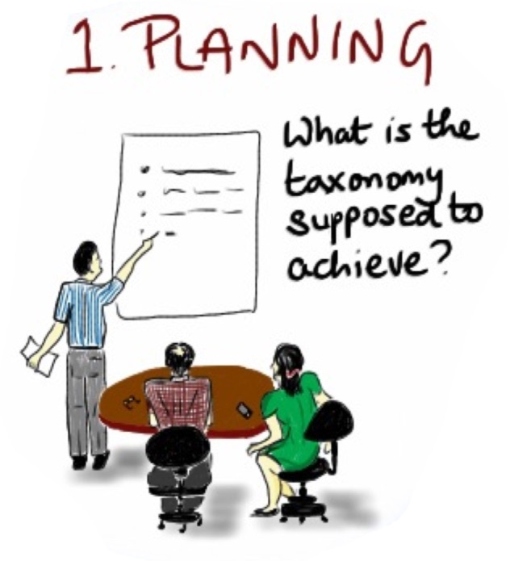
Planning: Purpose, Scope (Content and People)
What business problem are we trying to solve?
What is the content we are trying to organise?
Who are the user communities we are trying to serve?
What are we going to exclude as out of scope?
(Users are anyone who touches the lifecycle of the content)

Slide 11
Your Project

Slide 12
PART TWO: EVIDENCE-BASED DEVELOPMENT

Slide 13
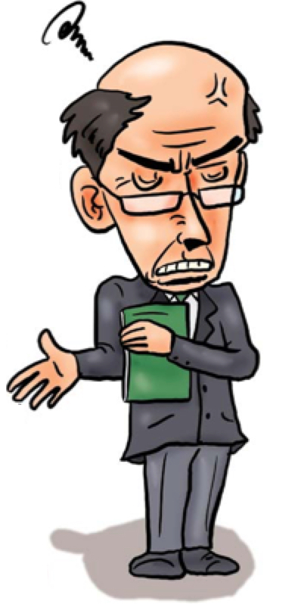
The Expertise Trap

Slide 14
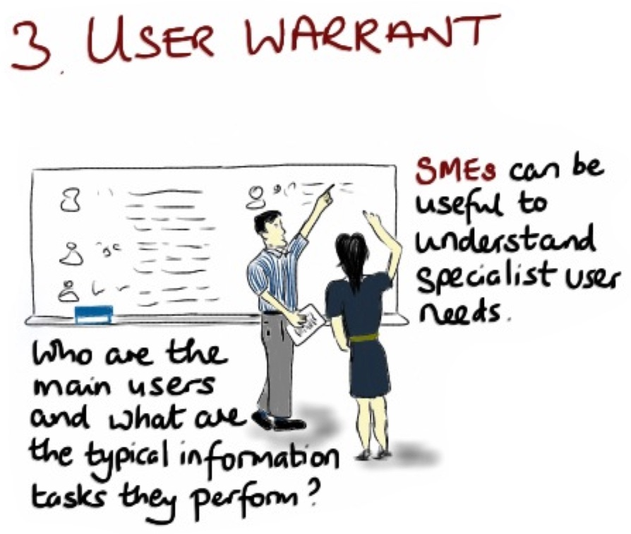
Design = evidence + desired outcomes
Understand the information resources – content warrant
Understand the users and their key tasks – user warrant
Understand if information needs to be exchanged with other agencies in standard forms – standards warrant
Warrant – the evidence behind your design

Slide 15
Evidence-based Design
You must have use-cases – to develop and to test the taxonomy – user warrant
Your taxonomy must reflect your current content and be hospitable to likely growth – content warrant
Use standard vocabularies as sources if you need to exchange with other agencies – standards warrant – (do you need to take just the terms or also the structures?)

Slide 16
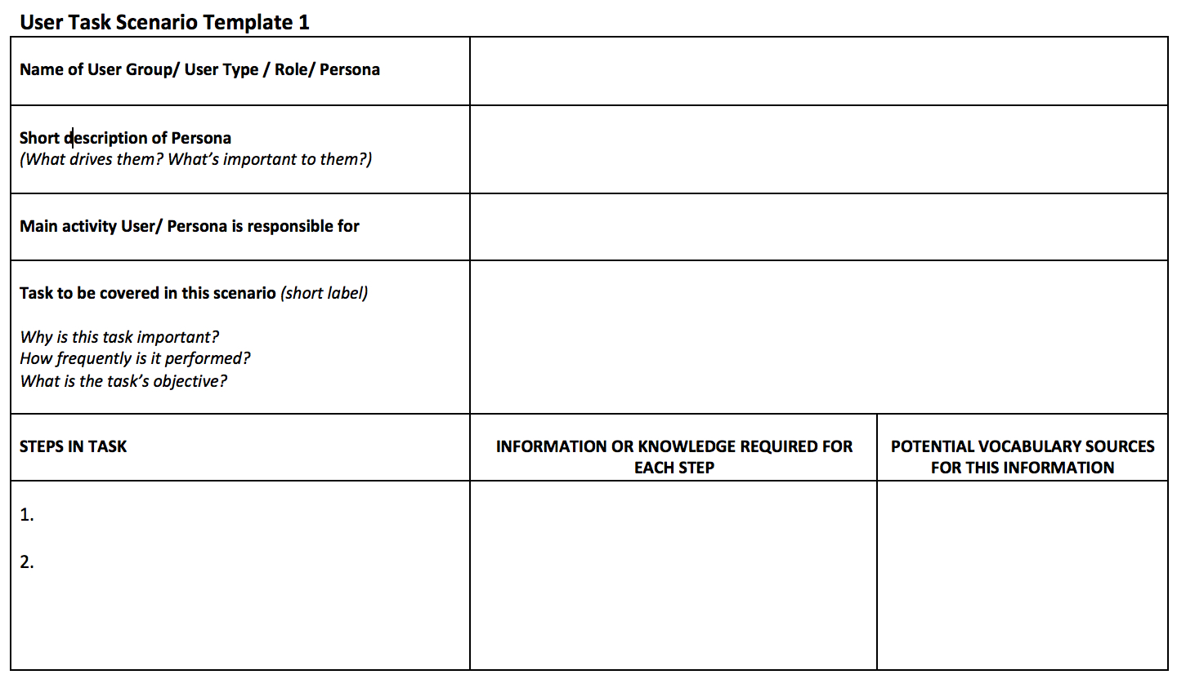
Exercise: Use case scenarios
Collectively, a diverse and representative range of use case scenarios produce a composite picture of
User warrant
Content warrant
Standards warrant

Slide 17
Content Modeling: Islamic Finance Educational Institution
www.inceif.org

Slide 18
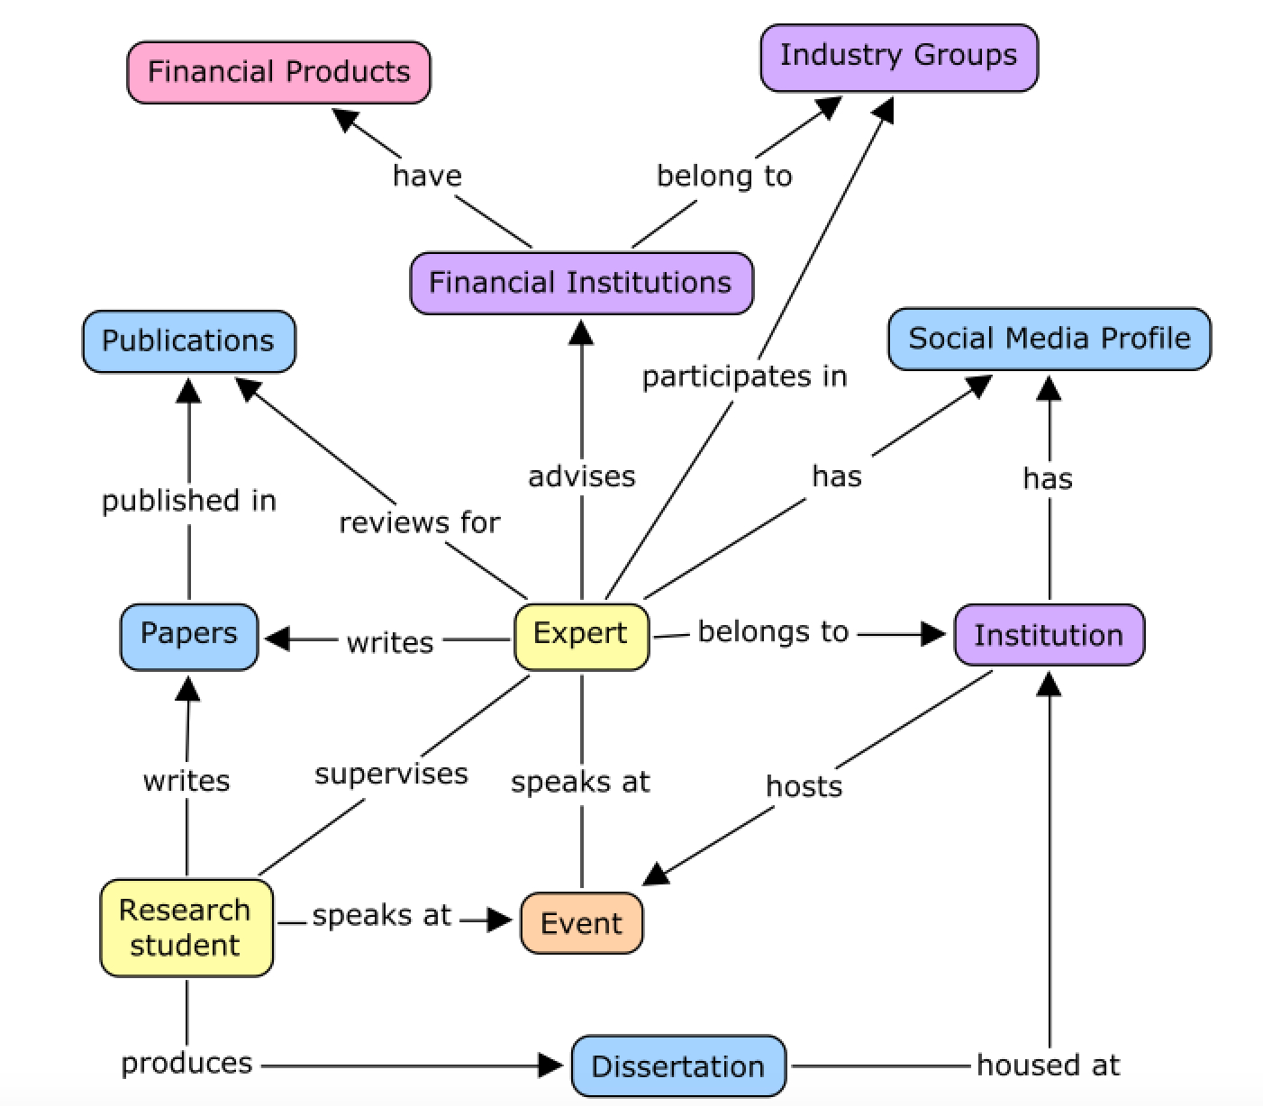
Content model (high level): Islamic Finance Taxonomy

Slide 19
- Islam
- Fiqh Muamalat
- Islamic finance
Islamic Capital Markets
etc
Event Topic
Event Title
Event Start Date
Event Acronym
Event End Date
Event
Event Location
City, country
Expert
Event Description
Event Type
Institution
Conference
Colloquium
Workshop/ Training
Seminar
Forum
Symposium
Round table
Roadshow
Talk/ Knowledge sharing session
Expo/ exhibition
Competition
Organizer
Institution
University
Association

Slide 20
Examples: Adjunct Professor, Professor, Associate Professor, Datuk, Dr.
Head of Department
Lecturer
Dean
Associate Dean
Name
Title
Designation
Education/ Qualification
PhD
Masters
(include higher learning institution)
Professional membership
Committee
Association
Field of Expertise
Expert
Taught Courses
- Islam
- Fiqh Muamalat
- Islamic finance
Islamic Capital Markets
etc
Publication
Report
Case study
Scholarly publication
Book
Working experiences
Contact information
Institution
Academic
Industry
E-mail
Telephone number (office
Web address
LinkedIn
Research gate
Events

Slide 21
Facets from content models: Islamic Finance Taxonomy
Document types
Event Types
Islamic Finance Topics
Institution Types
Islamic Finance Products

Slide 22
Exercise: from use cases to vocabularies to content models - which taxonomy facets will you build?

Slide 23
Criteria for term selection

Slide 24
Criteria
Do we need it?
Is it useful?
Will it work?

Slide 25
Do we need it?
Warrant – do we have warrant for the term? (an opinion isn’t warrant, a document or a task in which the term is used is warrant)
Standardization – is the term part of a standard vocabulary required for information exchange or compliance with a requirement?
Implication – does the acceptance of a candidate term imply the addition of more terms, for completeness?
Structure – does the acceptance of a new term or terms imply the creation of a new category or facet?

Slide 26
Will it be useful?
Novelty – does the term represent a new concept not already in the taxonomy?
Distinctiveness – does the term clearly represent a distinction that is important to the audience(s)?
Currency – does the term reflect the most common current usage for the underlying concept?
Appropriacy – is the term appropriate to the intended user communities?

Slide 27
Will it work?
Belonging – does the concept fit within the intended taxonomy structure (category or facet)?
Consistency – is the term stylistically consistent with other terms in that structure?
Technical accuracy – does the term accurately convey the intended meaning to the intended audience?
Transparency – does the term transparently convey the concept to users without ambiguity or competing interpretations, and without the need for special explanation or training?

Slide 28
Exercise: Building the Taxonomy!

Slide 29
Testing and Validation
Open card sorting – when you don’t have good user warrant and want to understand how users cluster topics into categories.
Closed card sorting – when have drafted a facet structure and you want to test it by getting users to sort the topics into it. Will they be consistent with your predicted structure? Will they be consistent with each other? Do they understand the categories in the same way?
Card sorting tests simulate a browse-to-find activity – whether they will accurately predict where to find topics then they browse the taxonomy.

Slide 30
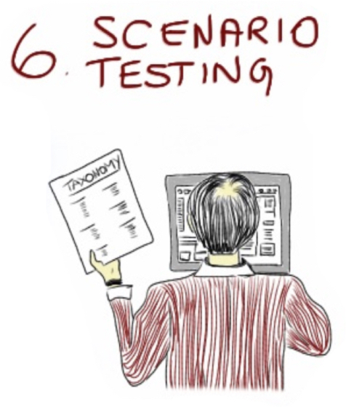
Testing and Validation
Scenario testing – 25-30 information seeking scenarios (drawn from user warrant - knowledge maps or use-case scenarios). In pairs or threes participants have to use the draft taxonomy to identify the topics they would use to search for the information in the scenario. They also identify keywords they would use that they can’t find in the taxonomy.
This test simulates a tagging activity using a taxonomy browse and predicts keywords used in search – using a reference taxonomy, will participants tag the same scenarios with similar concepts, how many tags and facets will they use, and how long will the task take them? How frequently do they use each of the facets?
If the consistency rate and number of tags/facets is relatively high, then manual tagging is likely to work well. If the task time is short, we are more likely to get effective manual tagging. We also find gaps in the taxonomy – if many scenarios are not tagged and lots of new term requests are made, the taxonomy has significant gaps (hospitality).

Slide 31
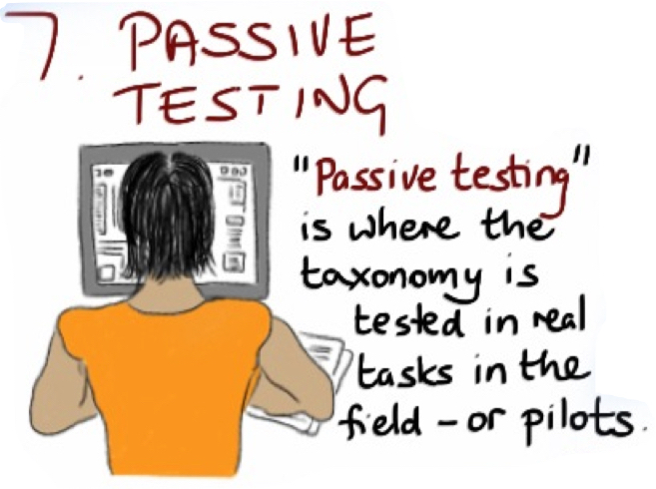
Testing and Validation
Card sorts and Scenario tests are “active” testing techniques – i.e. they are designed tasks to run with representative groups for quantitative analysis of their behaviours.
“Passive testing” means that you are observing real user actions on real content over a period of time, usually in a pilot phase, or in a small scale environment. It is not recommended for large scale roll-outs without active testing first because it may lead to taxonomy revisions affecting large numbers of users or large amounts of content. However it is useful for monitoring behaviour and harvesting data for taxonomy maintenance.
Testing techniques tell you about how to improve the content of the taxonomy, but more importantly they also tell you how the taxonomy should be implemented.

Slide 32
Testing and Validation
Balance and Load Testing – this test is used for taxonomies that have been in use for a while, and it looks at how content is distributed over the taxonomy.
To function as a “map” a taxonomy needs to break up content into clusters that can be surveyed and navigated sensibly.
If some categories are under-populated and seldom used, then either the topics are not useful, or the structure is too complex for them to be found easily in tagging.
If some categories are over-populated then it will not be easy to scan and make sense of them, and they probably need to be broken down into sub-categories.

Slide 33
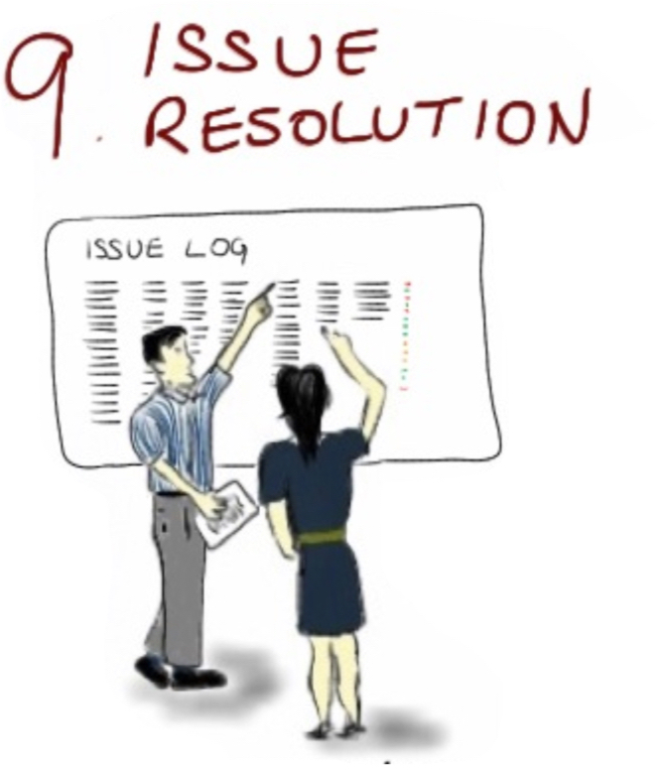
Testing and Validation
Issue logs –
Pick up and resolve issues noted in the test sessions.
Identify issues that require technical input from SMEs on technical accuracy, disambiguation, gaps.
Document the rationales for change decisions, and set precedents, for future reference (in ongoing taxonomy maintenance).

Slide 34
Thank You!
plambe@straitsknowledge.com
www.straitsknowledge.com

