Slide 1
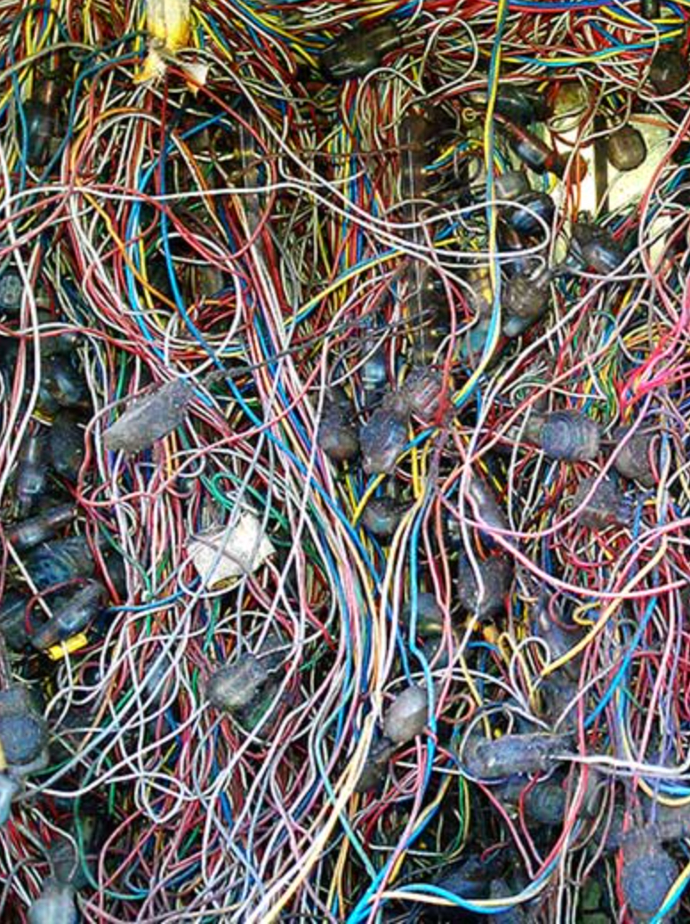
Taxonomy & Search Disasters and How To Avoid Them
Patrick Lambe
KK Lim
Maish Nichani
ISKO Singapore
August 2017

Slide 2
Agenda
Sharing: Projects with hard lessons (Singapore and international)
Activity: How to sabotage a taxonomy and search project (or not)
Exercise: Spotting the traps - reviewing a sample ITQ

Slide 3
Think About
Before a project – how it is scoped and framed
During a project – how it is delivered
After a project – how the benefits are sustained

Slide 4

The Magic Box (Before)
Telco company: search in a box
Government agency: move everything to a new platform
What’s the story?
It’s just about technology

Slide 5

The Magic Consultant (Before & During)
Global multinational: don’t disturb our people
Educational institution: analyse and recommend
Government agency: review and sign off
What’s the story?
There is a perfect context-free taxonomy

Slide 6
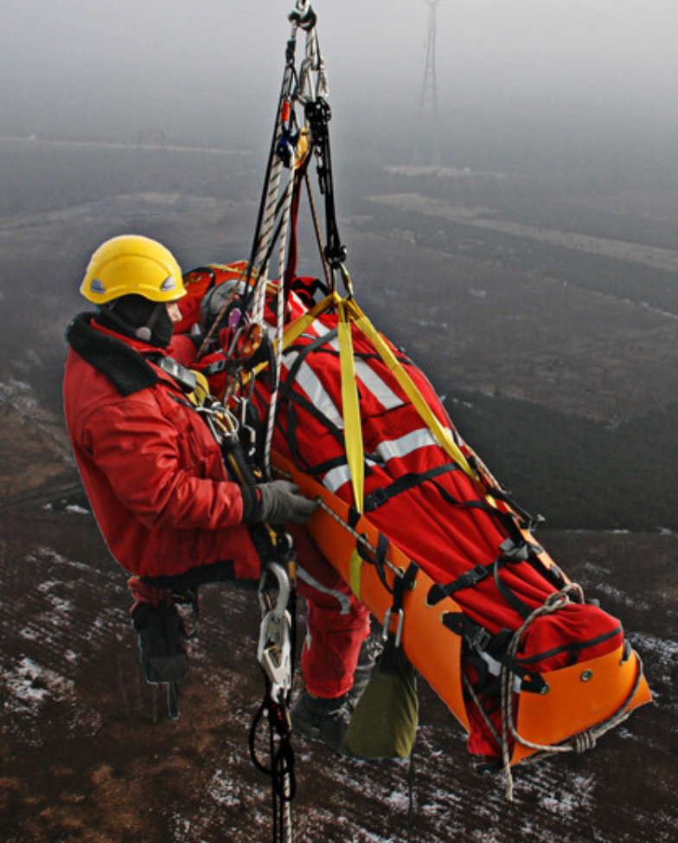
The Rescue Mission (Before & During)
R&D and Engineering Organization: oops we do need a taxonomy after all
Government agency: just configure the search engine
Government agency: just give us the methodology and check our results
What’s the story?
It’s just about the right steps

Slide 7
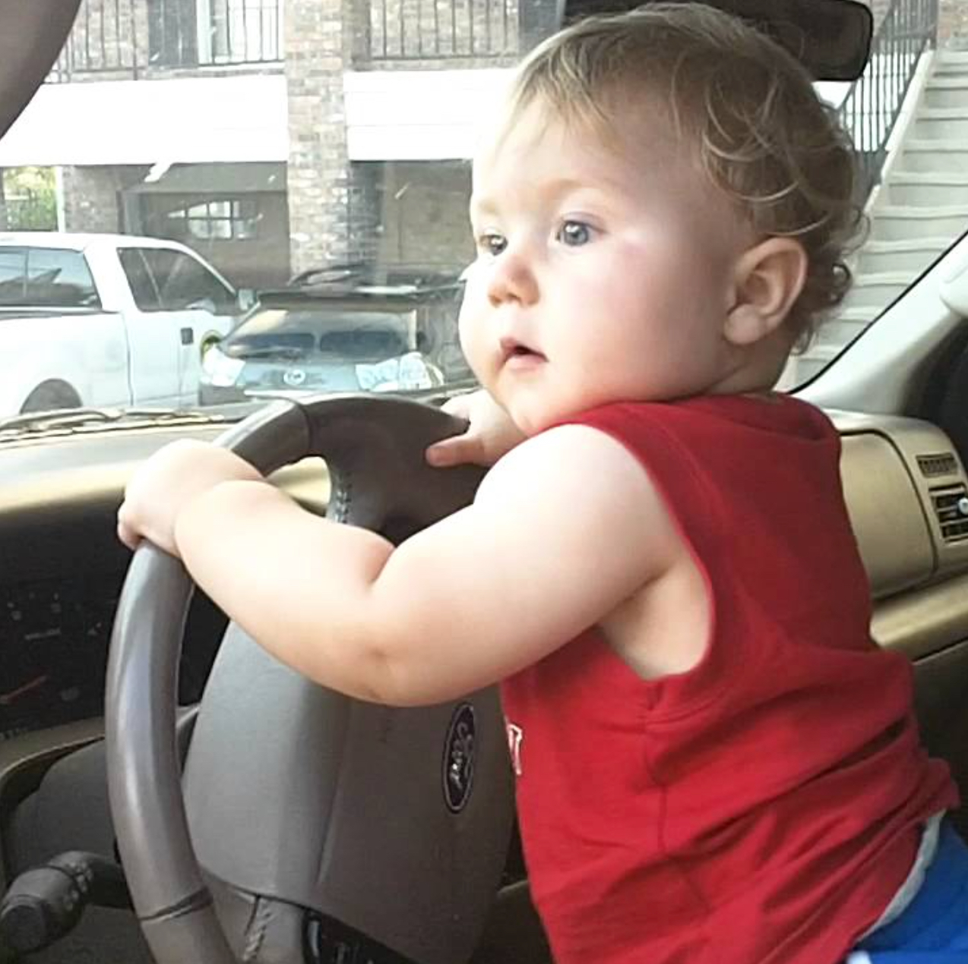
Ballooning out of Control (After)
Government agency: supersized delegated taxonomy
eCommerce site: getting the ratio of categories to content, and the maintenance costs right
Funding agency: noisy search
What’s the story?
Size for optimization and sustainability

Slide 8

Project Dementia (After)
Global media organisation: over-ambitious goals, resource slippage, bleeding expertise
Major Bank: hit your targets and disband
What’s the story?
What you learn is a resource

Slide 9
Common Themes?
The Magic Box
The Magic Consultant
The Rescue Mission
Ballooning out of Control
Project Dementia

Slide 10

How to Sabotage a Taxonomy & Search Project
Identify the things you can do to make sure a taxonomy and search project fails!
Before
During
After

Slide 11
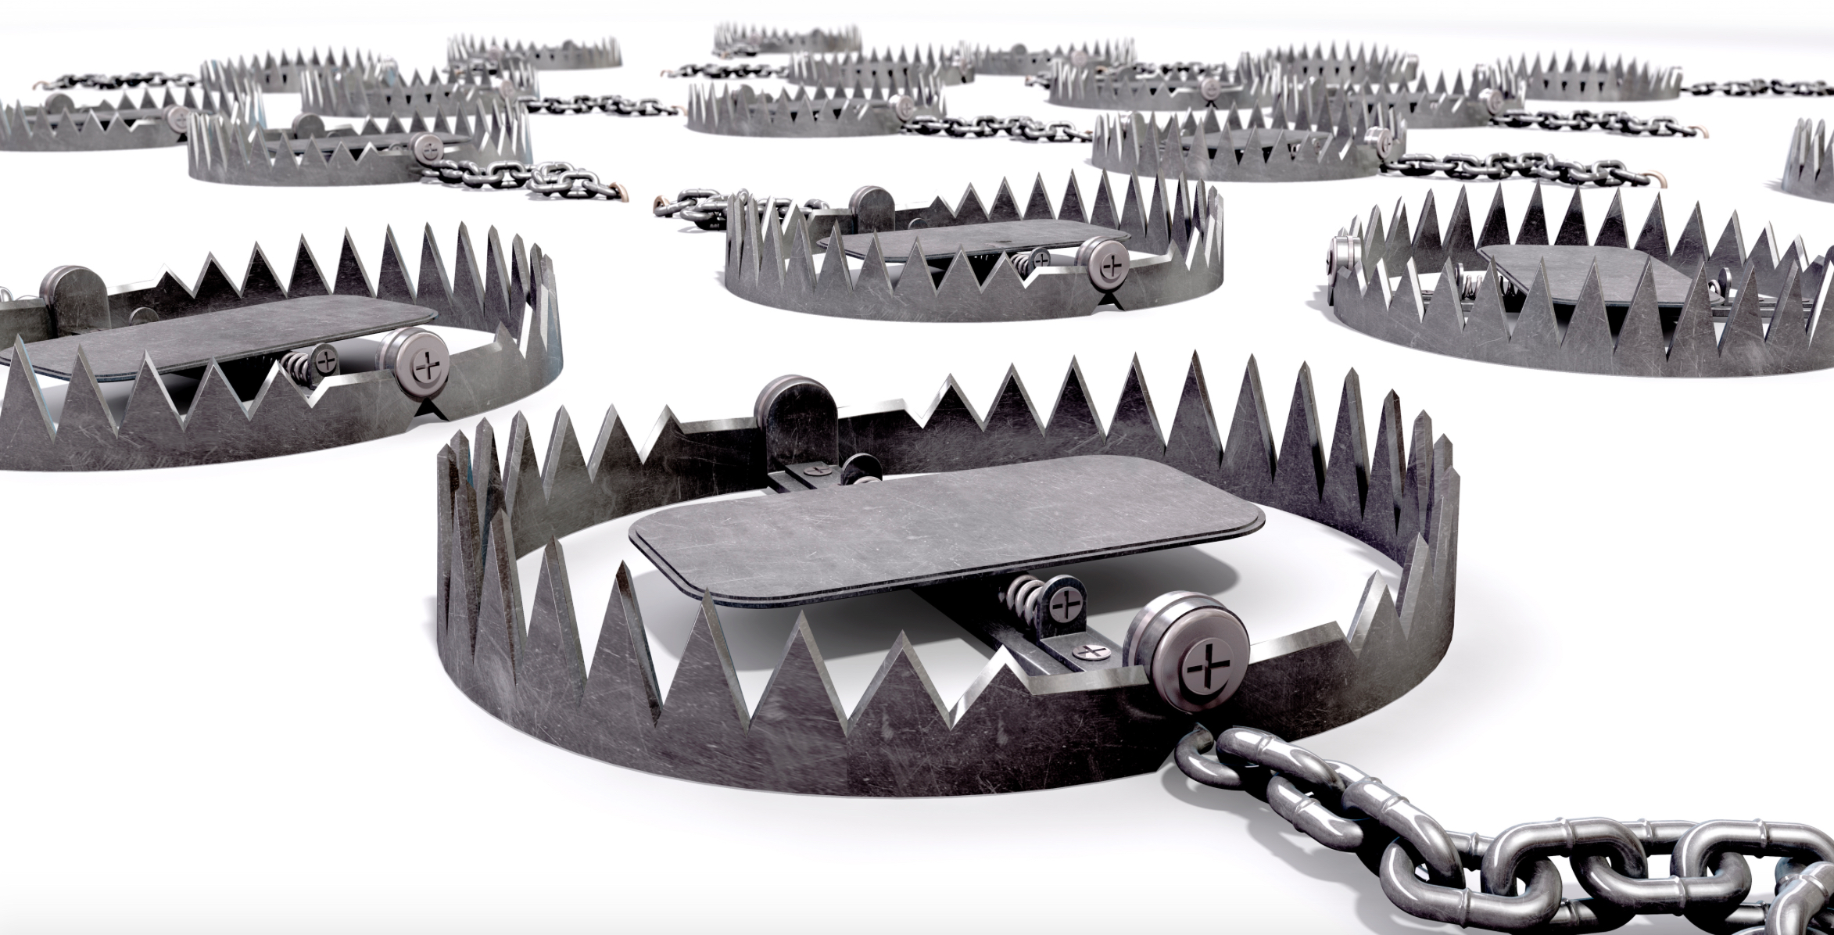
Exercise: Spotting the Traps

Slide 12
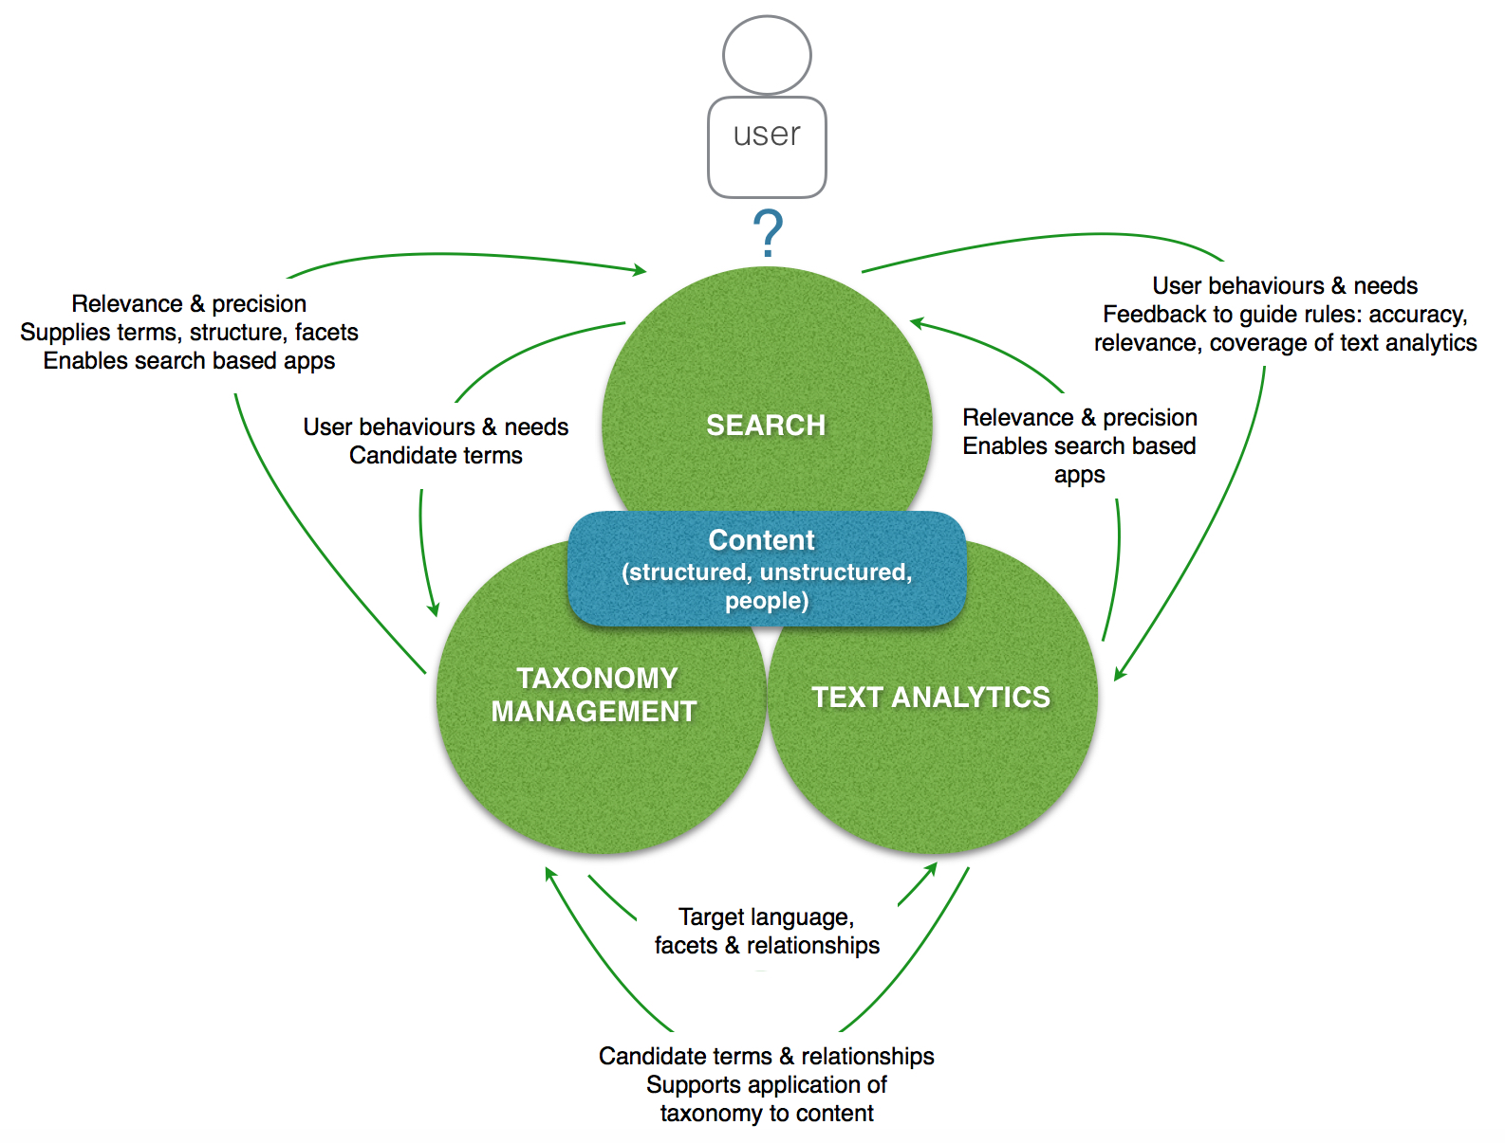
Recognition (term match)
Statistical patterns (similarity)
Semantic analysis (intent)

Slide 13
Questions!
plambe@straitsknowledge.com
kklim@milkkconsulting.com
maish@pebbleroad.com

