Slide 1

Better Virtual Workshops
Getting started designing, developing
and facilitating online workshops, Part 1 with Nancy White, Full Circle Associates

Slide 2

Getting into it together
Take a moment to make yourself comfortable and close your emails!
It’s nice to mute yourself if you’re not talking, and it helps everyone out
Move into Gallery View
If you are having Technical Issues, please send Nancy or Patrick a private message.
Notes:
6pm Seattle time/9am Singapore time

Slide 3

Calm Tea/
Chatterfall
I’ll give you a prompt.
You type your answer in the chat box, BUT DON’T HIT ENTER until I signal.
When I say enter, scroll back and read a few entries.
A riff on http://www.liberatingstructures.com/1-1-2-4-all/ and Mad Tea http://www.liberatingstructures.com/mad-tea
Notes:
Image from https://pixabay.com/photos/godafoss-iceland-waterfall-falls-1840758/

Slide 4
Calm Tea/Chatterfall Prompts
My engagement in meetings is diminished when ..
I feel most connected to others online when…
The best experience I’ve had in an online workshop was when…
The worst experience I’ve had in an online workshop was when…
For my next virtual workshop I most want to learn to...

Slide 5
Calm Tea/Chatterfall Debrief
What did you notice?
What was made possible?
How might you use this in one of your workshops?

Slide 6


Slide 7

Workshop Purpose
This workshop exists to help you build a practice for designing and facilitating purposeful, engaging virtual workshops that engage and unleash everyone.
We will know we are making progress when we can clearly define the purpose of our workshops, have developed a repertoire for designing and facilitating activities that serve the workshop purpose, and have identified our next steps for our upcoming workshops.

Slide 8




Our (Visual) Agenda - Virtual Workshops #1
Methods: Introduction to Liberating Structures
10 mins
Welcome/ Calm Tea (Ways to get a group started online…) 20 mins
Troika
20 mins breakout
10 mins debrief
Resources, Homework and Next Gathering
Agenda Overview
5 mins
Purpose Drives Everything
1 - 2- 9 Whys - All
Purpose Statement First Draft
30 mins
Reflections/
Just Three Words / 5 mins

Slide 9





Agenda - Virtual Workshops #2
Appreciative Interviews (or another structure as time allows)
Welcome/
Impromptu Networking
Digging Deeper into Liberating Structures
What? So What? Now What?
Agenda Overview
5 mins
Creative Destruction with TRIZ
Your 15% Solution/
Goodbyes

Slide 10

Workshop Purpose - Nine Whys
A workshop is NOT a laundry list...
Make the purpose of your
workshop clear together...
What is the reason for our workshop? How should we organize to meet the deep need we serve?
http://www.liberatingstructures.com/3-nine-whys/
Notes:
1. Structuring Invitation
Ask, “What do you do when working on ______ (the subject matter or challenge at hand)? Please make a short list of activities.” Then ask, “Why is that important to you?” Keep asking, “Why? Why? Why?” up to nine times or until participants can go no deeper because they have reached the fundamental purpose for this work.
2. How Space Is Arranged and Materials Needed
Unlimited number of groups
Chairs for people to sit comfortably face-to-face; no tables or equipment needed.
3. How Participation Is Distributed
Everyone has an equal opportunity to participate and contribute
4. How Groups Are Configured
First pairs, then groups of four, then the whole group (2-4-All)
5. Sequence of Steps and Time Allocation
Each person in a pair is interviewed by his or her partner for 5 minutes. Starting with “What do you do when working on ____?” the interviewer gently seeks a deeper answer by repeating the query: “Why is that important to you?” Switch roles after 5 minutes. 10 min.
Each pair shares the experience and insights with another pair in a foursome. 5 min.
Invite the whole group to reflect by asking, “How do our purposes influence the next steps we take?” 5 min.

Slide 11
Workshop Purpose - Nine Whys
A workshop is NOT a laundry list...
Individually make a list of the things that you do plan and do your workshop. Type them in your breakout room chat. Read what others have written. (2 mins)
One member of the group plays the client, another is the interviewer. The interviewer will ask why your work is important to you. Everyone else listen closely for clarity. [4 minute interview]
Now, switch roles. Someone else tries as client, and another as interviewer. Keep going until you get a message to wrap up and we’ll come back to plenary. (15 mins total)
You will get a message delivered to your room when it is time to switch.
http://www.liberatingstructures.com/3-nine-whys/
Notes:
1. Structuring Invitation
Ask, “What do you do when working on ______ (the subject matter or challenge at hand)? Please make a short list of activities.” Then ask, “Why is that important to you?” Keep asking, “Why? Why? Why?” up to nine times or until participants can go no deeper because they have reached the fundamental purpose for this work.
2. How Space Is Arranged and Materials Needed
Unlimited number of groups
Chairs for people to sit comfortably face-to-face; no tables or equipment needed.
3. How Participation Is Distributed
Everyone has an equal opportunity to participate and contribute
4. How Groups Are Configured
First pairs, then groups of four, then the whole group (2-4-All)
5. Sequence of Steps and Time Allocation
Each person in a pair is interviewed by his or her partner for 5 minutes. Starting with “What do you do when working on ____?” the interviewer gently seeks a deeper answer by repeating the query: “Why is that important to you?” Switch roles after 5 minutes. 10 min.
Each pair shares the experience and insights with another pair in a foursome. 5 min.
Invite the whole group to reflect by asking, “How do our purposes influence the next steps we take?” 5 min.

Slide 12
Workshop Purpose - Nine Whys
A workshop is NOT a laundry list...
Partner 2: Start asking Why…
  Why is this work important to YOU?
  First answer, “_______….” Hmmm, why is that important to you?
  Second answer, “_______….” OK, if your dream came true last night, what would be different for the people you are serving?
Keep asking, “Why… why… why… until you make a discovery about your partner’s bedrock purpose. Actively listen, digging deeper and deeper…
http://www.liberatingstructures.com/3-nine-whys/
Notes:
1. Structuring Invitation
Ask, “What do you do when working on ______ (the subject matter or challenge at hand)? Please make a short list of activities.” Then ask, “Why is that important to you?” Keep asking, “Why? Why? Why?” up to nine times or until participants can go no deeper because they have reached the fundamental purpose for this work.
2. How Space Is Arranged and Materials Needed
Unlimited number of groups
Chairs for people to sit comfortably face-to-face; no tables or equipment needed.
3. How Participation Is Distributed
Everyone has an equal opportunity to participate and contribute
4. How Groups Are Configured
First pairs, then groups of four, then the whole group (2-4-All)
5. Sequence of Steps and Time Allocation
Each person in a pair is interviewed by his or her partner for 5 minutes. Starting with “What do you do when working on ____?” the interviewer gently seeks a deeper answer by repeating the query: “Why is that important to you?” Switch roles after 5 minutes. 10 min.
Each pair shares the experience and insights with another pair in a foursome. 5 min.
Invite the whole group to reflect by asking, “How do our purposes influence the next steps we take?” 5 min.

Slide 13
Workshop Purpose - Nine Whys
A workshop is NOT a laundry list...
Share your experience & insights by trying your hand at an 9 word purpose statement first alone, and then together.
Capture your final version in your team slide.
http://www.liberatingstructures.com/3-nine-whys/
Notes:
1. Structuring Invitation
Ask, “What do you do when working on ______ (the subject matter or challenge at hand)? Please make a short list of activities.” Then ask, “Why is that important to you?” Keep asking, “Why? Why? Why?” up to nine times or until participants can go no deeper because they have reached the fundamental purpose for this work.
2. How Space Is Arranged and Materials Needed
Unlimited number of groups
Chairs for people to sit comfortably face-to-face; no tables or equipment needed.
3. How Participation Is Distributed
Everyone has an equal opportunity to participate and contribute
4. How Groups Are Configured
First pairs, then groups of four, then the whole group (2-4-All)
5. Sequence of Steps and Time Allocation
Each person in a pair is interviewed by his or her partner for 5 minutes. Starting with “What do you do when working on ____?” the interviewer gently seeks a deeper answer by repeating the query: “Why is that important to you?” Switch roles after 5 minutes. 10 min.
Each pair shares the experience and insights with another pair in a foursome. 5 min.
Invite the whole group to reflect by asking, “How do our purposes influence the next steps we take?” 5 min.

Slide 14
Workshop Purpose Statement
Template
Workshop Purpose
Our workshop exists to ___ (do/make what?) so that _____ (the participants, stakeholders, sponsors)________(what does this make available/enable for them?).
We will know we are making progress on our purpose when _______ (indicators, actions, etc.)

Slide 15
Workshop Purpose Statement
Example 1
Workshop Purpose
Our workshop exists to understand current pain points and to explore future state of document creation lifecycle_ so that the KM and IT partners will be able to design fit-for-purpose and user friendly processes for staff to create documents easily in the document management system.
We will know we are making progress on our purpose when we are able to agree and finalise on the document creation workflow for both current and future state.

Slide 16
Workshop Purpose Statement
Example 2
Workshop Purpose
Our session exists to help new hires get to know each other (establish trust and connection)___(do/make what?) so that they (the participants, stakeholders, sponsors)_can connect with colleagues with similar interests, build good rapport and networks(what does this make available/enable for them)_for effective collaboration within the organisation.
We will know we are making progress on our purpose when participants are able to complete the asssigned task together within given timeslot without nudging (indicators, actions, etc.)

Slide 17
Workshop Purpose Statement
Example 3
Workshop Purpose
Our workshop exists to get objective qualitative feedback about our KM & Learning initiatives so that everybody in our organisation will improve their productivity/ efficiency and experience and help shape our future programs.
We will know we are making progress on our purpose when we hear from people who have concrete examples on how we have made their working lives better.

Slide 18
Workshop Purpose Statement
4 - Independent Group
Workshop Purpose
Our workshop exists to educate a student audience about organizational communication so that students (the participants, stakeholders, sponsors) will have confidence to manage organizational communication by providing solutions for future challenges(what does this make available/enable for them).
We will know we are making progress on our purpose when (indicators, actions, etc.) students can independently create their own plans____.

Slide 19
9 Whys/Purpose Statement Debrief
What did you notice?
What was made possible?
How might you use this in one of your workshops?

Slide 20
STRETCCCCCHHHHH
BREAAAAAKKKKKKK

Slide 21
Troika Consulting
Getting actionable help from peers
What is made possible? You can help people gain insight on issues they face and unleash local wisdom for addressing them. In quick round-robin “consultations,” individuals ask for help and get advice immediately from two others. Peer-to-peer coaching helps with discovering everyday solutions, revealing patterns, and refining prototypes.
Give and get practical and imaginative help from your colleagues immediately
http://www.liberatingstructures.com/8-troika-consulting/
Notes:
1. Structuring Invitation
Invite the group to explore the questions “What is your challenge?” and “What kind of help do you need?”
2. How Space Is Arranged and Materials Needed
Any number of small groups of 3 chairs, knee-to-knee seating preferred. No table!
3. How Participation Is Distributed
In each round, one participant is the “client,” the others “consultants”
Everyone has an equal opportunity to receive and give coaching
4. How Groups Are Configured
Groups of 3
People with diverse backgrounds and perspectives are most helpful
5. Sequence of Steps and Time Allocation
Invite participants to reflect on the consulting question (the challenge and the help needed) they plan to ask when they are the clients. 1 min.
Groups have first client share his or her question. 1-2 min.
Consultants ask the client clarifying questions. 1-2 min.
Client turns around with his or her back facing the consultants
Together, the consultants generate ideas, suggestions, coaching advice. 4-5 min.
Client turns around and shares what was most valuable about the experience. 1-2 min.
Groups switch to next person and repeat steps.

Slide 22
Troika Steps
Client spend 1 minutes explaining your challenge/what you want help with for an upcoming workshop you are planning
Consultants spend 2 minutes asking clarifying questions only
Client turn off your camera/mic and grab pen/paper. Turn around to listen more closely
Consultants spend 4 minutes discussing the issue with each other.
Client turn on camera, offer thanks and offer one thing you heard that was helpful.
Switch partners to the next client. If you go fast, you can fit in a third “client”
http://www.liberatingstructures.com/8-troika-consulting/
Notes:
1. Structuring Invitation
Invite the group to explore the questions “What is your challenge?” and “What kind of help do you need?”
2. How Space Is Arranged and Materials Needed
Any number of small groups of 3 chairs, knee-to-knee seating preferred. No table!
3. How Participation Is Distributed
In each round, one participant is the “client,” the others “consultants”
Everyone has an equal opportunity to receive and give coaching
4. How Groups Are Configured
Groups of 3
People with diverse backgrounds and perspectives are most helpful
5. Sequence of Steps and Time Allocation
Invite participants to reflect on the consulting question (the challenge and the help needed) they plan to ask when they are the clients. 1 min.
Groups have first client share his or her question. 1-2 min.
Consultants ask the client clarifying questions. 1-2 min.
Client turns around with his or her back facing the consultants
Together, the consultants generate ideas, suggestions, coaching advice. 4-5 min.
Client turns around and shares what was most valuable about the experience. 1-2 min.
Groups switch to next person and repeat steps.

Slide 23
Clarifying Questions are simple questions of fact.
Is this what you said…?
What resources were used for the project?
Did I hear you say…?
Did I understand you when you said…?
What criteria did you use to…?
Did I hear you correctly when you said…?
http://www.liberatingstructures.com/8-troika-consulting/
Notes:
1. Structuring Invitation
Invite the group to explore the questions “What is your challenge?” and “What kind of help do you need?”
2. How Space Is Arranged and Materials Needed
Any number of small groups of 3 chairs, knee-to-knee seating preferred. No table!
3. How Participation Is Distributed
In each round, one participant is the “client,” the others “consultants”
Everyone has an equal opportunity to receive and give coaching
4. How Groups Are Configured
Groups of 3
People with diverse backgrounds and perspectives are most helpful
5. Sequence of Steps and Time Allocation
Invite participants to reflect on the consulting question (the challenge and the help needed) they plan to ask when they are the clients. 1 min.
Groups have first client share his or her question. 1-2 min.
Consultants ask the client clarifying questions. 1-2 min.
Client turns around with his or her back facing the consultants
Together, the consultants generate ideas, suggestions, coaching advice. 4-5 min.
Client turns around and shares what was most valuable about the experience. 1-2 min.
Groups switch to next person and repeat steps.

Slide 24
Suggestions
One of the consultants act as timekeeper for each round.
Try the timing out- it’s quick but it also can be revelatory that it’s possible to give and get help in so little time.
Let go and relax as you listen, be open to receiving.
At the conclusion of the 3 rounds, consider together:
  Any patterns/ common themes to the challenges?
  Anything surprising come up for you in the process?
  Any reflections you want to share back with the larger group?
http://www.liberatingstructures.com/8-troika-consulting/
Notes:
1. Structuring Invitation
Invite the group to explore the questions “What is your challenge?” and “What kind of help do you need?”
2. How Space Is Arranged and Materials Needed
Any number of small groups of 3 chairs, knee-to-knee seating preferred. No table!
3. How Participation Is Distributed
In each round, one participant is the “client,” the others “consultants”
Everyone has an equal opportunity to receive and give coaching
4. How Groups Are Configured
Groups of 3
People with diverse backgrounds and perspectives are most helpful
5. Sequence of Steps and Time Allocation
Invite participants to reflect on the consulting question (the challenge and the help needed) they plan to ask when they are the clients. 1 min.
Groups have first client share his or her question. 1-2 min.
Consultants ask the client clarifying questions. 1-2 min.
Client turns around with his or her back facing the consultants
Together, the consultants generate ideas, suggestions, coaching advice. 4-5 min.
Client turns around and shares what was most valuable about the experience. 1-2 min.
Groups switch to next person and repeat steps.

Slide 25
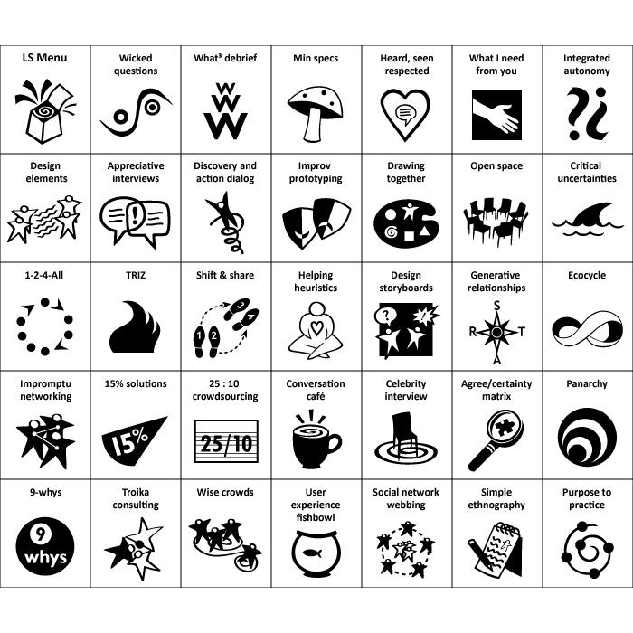
What are Liberating Structures?
Simple social technologies that distribute participation more widely while drawing out greater difference and variation within groups
A repertoire of techniques that reliably generate novelty
A pattern library for organizing groups to collaborate and mutually shape their work together
A collection of tools & facilitation techniques that share a similar logic or organizing structure
Tiny methods that make it possible to benefit from complexity instead of flattening, ignoring, and pushing it away
Notes:
10 minutes

Slide 26
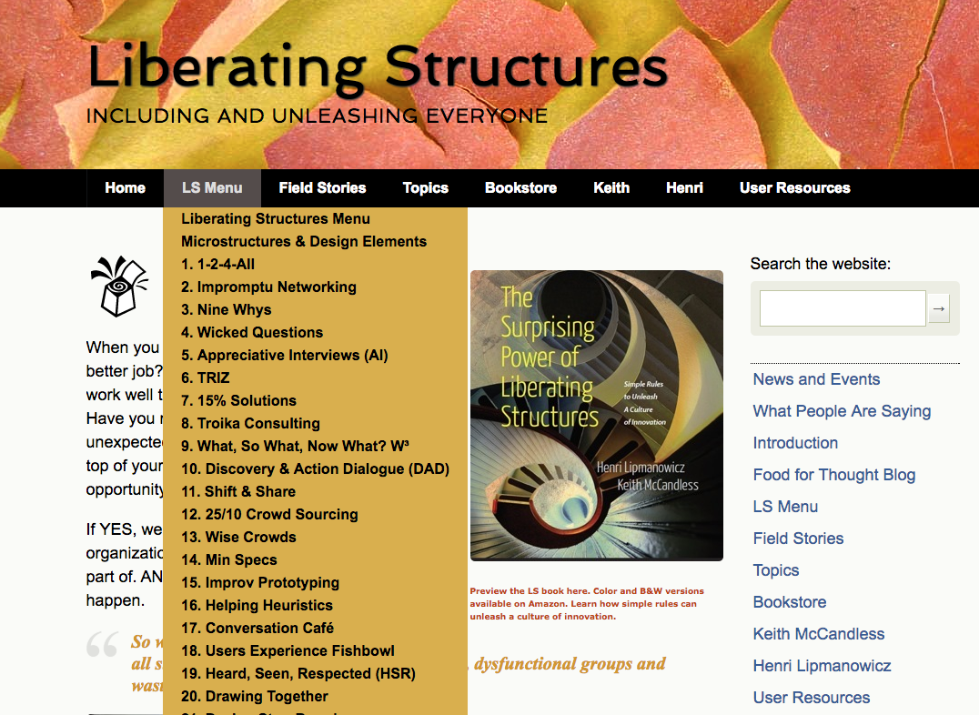
Liberating Structures are…
“Serious Fun”
Purpose-full, Flexible, Familiar?
FREE!
Tour the Website http://www.liberatingstructures.com
Learn more about Liberating Structures https://medium.com/@keithmccandless/liberating-structures-change-methods-for-everybody-every-day-648e9c0d04a7
Emerging Virtual Handbook https://docs.google.com/document/d/1Ph0A-FOPoYY_1KSej7Uq5Yyc6X33kZLLaMyiHbV55sg/edit
Notes:
LS are
designed to have a “serious fun” factor to unleash &include everyone. They LOOK busy & noisy, but there is an order there, in fact, we control a few things a LOT, and let the wild rumpus unfold for short periods of time
Designed to support specific PURPOSES…the idea is to articulate your purpose first, then pick your structure
Flexible: I,e., , adaptable AND scalable… adaptable: customize by structuring the invitation carefully, and .scalable: use w/very sm & lg groups.
Familiar? You are all already using activities that work well to engage your students and support their learning. You may recognize aspects of what you already do in many of the LS activities. It’s not uncommon for someone to say, “oh I know that activity, but we call it _________” We encourage you to be curious about the differences you observe
LS are free – on the website, under the menu you will find the activities, with instructions, timing, riffs and variations and tips for success, even collateral like ppt slides you can use.

Slide 27



Made available through a Creative Commons Non-Commercial, Attribution, Share-and-Share Alike License
You can use ‘em, you can share ‘em,
but you can’t sell ‘em.
Slide content adapted from materials developed by
Keith McCandless and other LS practitioners.
Most photographs by Keith McCandless, Fisher Qua, and others as noted.
Notes:
https://docs.google.com/document/d/1T9kzGxxqecDXUsZvHQm-zq0HBw2vgPnJYDEfbQu2WNQ/edit

Slide 28

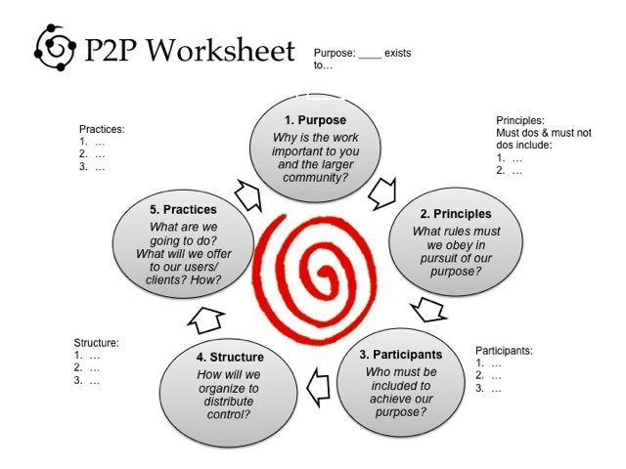
Homework: Purpose to Practice
http://www.liberatingstructures.com/33-purpose-to-practice-p2p/

Slide 30

Our journey so far...
Slow Tea/Chatterfall: Getting a workshop started
9 Whys - Designing for PURPOSE
9 Word Purpose Statement
Troika Consulting
Liberating Structures
Experiencing breakout rooms, use of chat and visual tools to complement the processes

Slide 31
Next Meeting & Your Homework
Methods: Introduction to Liberating Structures
10 mins
Welcome/ Impromptu Networking
Digging Deeper into Liberating Structures
What? So What? Now What?
Agenda Overview
5 mins
Creative Destruction with TRIZ
Your 15% Solution/Goodbyes

Slide 32
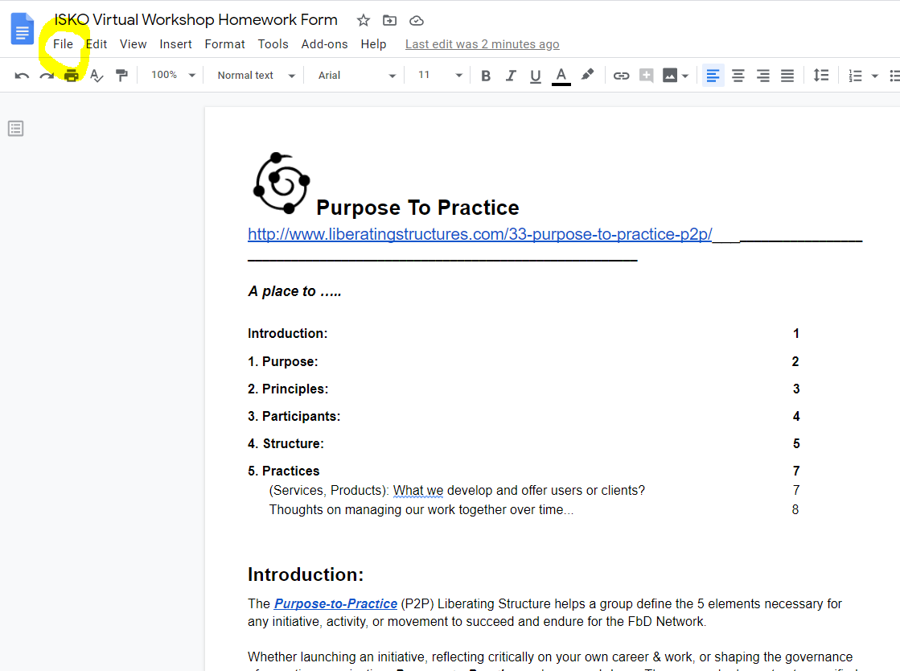
Worksheet
Instructions
https://docs.google.com/document/d/1L5QCO3MUnRI0jbXzMuvRxL0xwGRK7rwqQm9_YNj7bBA/edit?usp=sharing
File → Make a Copy
Rename w/ Your Name
Share with nancy.white@gmail.com

Slide 33
Planning: Once you have Purpose (Homework from here forward…)
Workshop Principles - Minimum Specs
What are the few things we must or must NOT do in our workshop?

Slide 34
Planning: Once you have Principles...
People
Who MUST be present to achieve our workshop purpose? What are their roles?

Slide 35
Planning: Once you have people...
Workshop Activities
To achieve our purpose, we must complete the following activities:
Hint: If you propose an activity, test to see if it is absolutely necessary to your purpose. Having trouble trimming out the extraneous? Try TRIZ.

Slide 36
Planning: Once you have Activities...
Processes/Methods
To complete our activities, we need the following processes
Activity | Process

Slide 37
Planning: Once you have processes...
What tools do we need to support our processes/methods?
Activity | Process | Tools

Slide 38
How do we know we are achieving our purpose?
What information, feedback and data do we need to know we are making progress towards our purpose? To follow up after the workshop?
Workshop Harvest | Feedback Mechanisms | Other Data

Slide 39
Closing Reflections - “Just Three Words”
Techniques to get feedback …
...in ways that every voice is heard…
...that you can benefit from in the moment, and process in more depth later.

Slide 40
Resources....
Check out http://www.liberatingstructures.com or the App
Emerging Virtual Handbook https://docs.google.com/document/d/1Ph0A-FOPoYY_1KSej7Uq5Yyc6X33kZLLaMyiHbV55sg/edit
Upcoming LS online events https://ls.qiqochat.com/events (create a free account and it will convert to your time zone!) and Liberating Structures Slack: Channels of interest: #pandemicresponse #virtual #tools
Annotated list of Liberating Structures related community resources (including a full slide deck): https://drive.google.com/open?id=1hlx3XPS1Er9s_UnjHCmMJwhFI3Qn_1PUnIPUsuYY1d0
DeConstruct/ReConstruct Worksheet with the 6 Knotworking Questions https://docs.google.com/document/d/1bU8efHbLGn2aXaC0oZSSU-4T1cxMy4XPongMUnB1jlg/edit#
General support for moving online during the pandemic online facilitators response group at https://groups.io/g/f4c-response and Emerging set of online meeting resources at https://docs.google.com/document/d/1NyrEU7n6IUl5rgGiflx_dK8CrdoB2bwyyl9XG-H7iw8/edit#
Virtual Meeting Power Dynamics https://aspirationtech.org/blog/virtualmeetingpowerdynamics
Stephan Morales on Workshop Design https://medium.com/@StefanMorales/workshop-design-has-never-been-more-important-than-now-4014e02059c9
Guide to Hosting Open Space online with Zoom and GoogleDocs https://docs.google.com/document/d/1x4oroj-ac3f4n_qqUHCBrbiFUvw54lRUDm8kDP6L3M4/edit?usp=sharing

Slide 41
BLANK

Slide 42
Room 1 Harvest -
Capture your ideas and questions, one per note, then pick the top idea and question to share.
Our MOST INSIGHTFUL IDEA:
Our MOST INSIGHTFUL QUESTION:

Slide 43
Room 2 Harvest -
Capture your ideas and questions, one per note, then pick the top idea and question to share.
Our MOST INSIGHTFUL IDEA:
Our MOST INSIGHTFUL QUESTION:

Slide 44
Harvest: Most Insightful Ideas
Our MOST INSIGHTFUL IDEA:
Our MOST INSIGHTFUL IDEA:
Our MOST INSIGHTFUL IDEA:
Our MOST INSIGHTFUL IDEA:
Our MOST INSIGHTFUL IDEA:
Our MOST INSIGHTFUL IDEA:

Slide 45
Harvest: Most Insightful Questions
Our MOST INSIGHTFUL QUESTION:
Our MOST INSIGHTFUL QUESTION:
Our MOST INSIGHTFUL QUESTION:
Our MOST INSIGHTFUL QUESTION:
Our MOST INSIGHTFUL QUESTION:

